Slide 1
Vertical Transition Unit to Reduce the Number of Patients who Leave Without Being Seen (LWBS)
Josh Norman, MD, Karan Shah, MD; Clifford Freeman, MD; Corey Slovis, MD; Stephan Russ, MD; Ian Jones, MD; Matt Sims, MSN; Kurt Wulliman, MMHC; Maya Yiadom, MD; Tyler Barrett, MD.
Department of Emergency Medicine, Vanderbilt University Medical Center

Slide 2
Background
In 2017 VUMC ED had 4.7% patients leave without being seen (LWBS)
Negative impact on patient safety as well as departmental and hospital revenue
In our experience high acuity patients were likely to be admitted, while lower acuity patients (ESI 3-5) waited due to not being sick or requiring additional ED workup

Slide 3
Hypothesis
Vertical transition unit (VTU) unit designed to select mid to low acuity waiting room patients that met criteria for likely discharge would decompress the Emergency Department and reduce LWBS rate and overall EDLOS.

Slide 4
Metrics
Primary outcomes:
  reduce left without being seen rate (LWBS)
  difference in overall EDLOS
Secondary outcomes:
  to reduce the individual sub-cycles of care that together comprise ED length of stay (LOS) for VTU patients.

Slide 5
Methodology
VTU was designed and piloted for 3 months (Monday-Thursday 1 pm- 9pm)
VTU composed of 5 chair spaces
Dedicated resident, nurse, paramedic, and rotating assigned attending physicians
Patients were selected from waiting room using VTU Eligibility Process and Flow Protocol

Slide 6
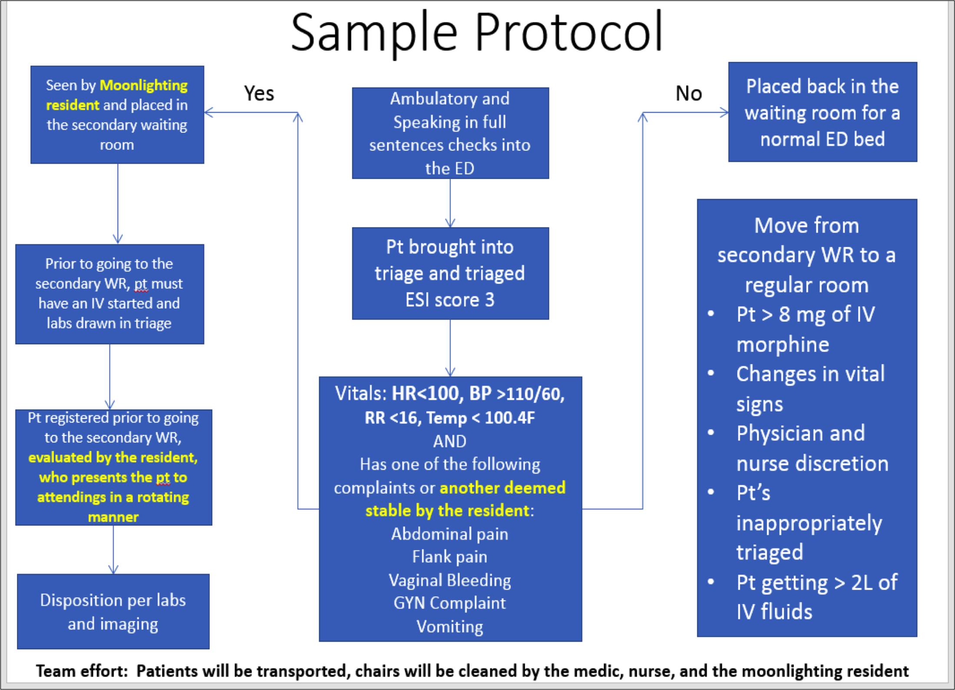
VTU Eligibility and Process Flow Protocol

Slide 7
Data Analysis
We considered the use of medians, but given that we were interested in the influence of outliers in what should be a consistent rapid-turnover unit, we opted to use means.

Slide 8
Results
Primary Outcomes
  Comparing Before and During the Pilot
LWBS rates 4.65% vs 4.89% were not significantly changed
Mean ED LOS 4.82 hours vs 4.67 hours were not significantly different

Slide 9
Results
Secondary Outcomes
VTUs ability to decompress the waiting room was compared to our Fast Track (Table 2).
More patients were seen in the VTU
Patient acuity was about the same in the VTU and FT (mean ESI 3.47 vs 3.33).
VTU LOS (2.7 hours vs 4 hours) was lower.

Slide 10
Results
In addition, sub-cycle components of EDLOS for VTU patients times were lower:
Work-up time was 1.7 hours vs 2.7 hours, and
Disposition-to-discharge time was 0.3 versus 0.5 hours.

Slide 11
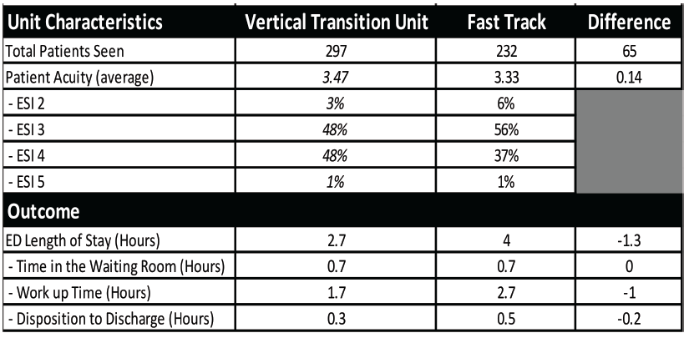
Results

Slide 12
Conclusions
The VTU model, improved ED throughput for mid and low acuity patients, and outperformed our Fast Track area despite seeing more patient volume

Slide 13
Conclusions
These results demonstrate gains in efficiency, however, the VTU did not reduce overall ED LOS or LWBS rates. A larger sample size and unit trial period may be needed to observe a translation of efficiency into reduce the ED’s LWBS.

