Slide 1
Reducing Non-Beneficial Variation in Emergency Department Chest Pain Evaluation
Robert Risch, MD., MBA, FACEP
John Garrett, MD., FACEP

Slide 2
background
Emergency Medicine and Cardiology literature has evolved to allow the rapid evaluation of patients with chest pain.
The risk stratification which previously required 24-hours of serial testing, can now be accomplished, in many cases, within the ED in 3-hours.
The aim of this project was to standardize the evaluation of potential acute coronary syndrome (ACS) across 14 hospitals though streamlined workflows, education, and individual provider feedback.

Slide 3
methods
A multidisciplinary group developed a best practice approach to the evaluation of ACS based upon AHA guidelines.
The approach to risk stratification, based upon HEART score and serial troponins, was then standardized across service lines utilizing systemwide governance councils.
The electronic healthcare record was streamlined to reinforce best practice and to allow capture of data pertaining to individual patient risk stratification and admission rates within each cohort of risk stratified by hospital and individual provider.

Slide 4
methods
Rollout:
An educational program highlighting risk stratification was developed.
Completion of the education was tracked electronically with feedback to site medical directors and the individual provider
Individual provider’s feedback as unblinded, 3-monthing rolling data on use of:
1) The risk stratification tool
2) Individual admission rates
3) The rate of admission in low risk patients
Month to month universal admission rates and admission rates in the low risk group were utilizing descriptive statistics and students t-test.

Slide 5
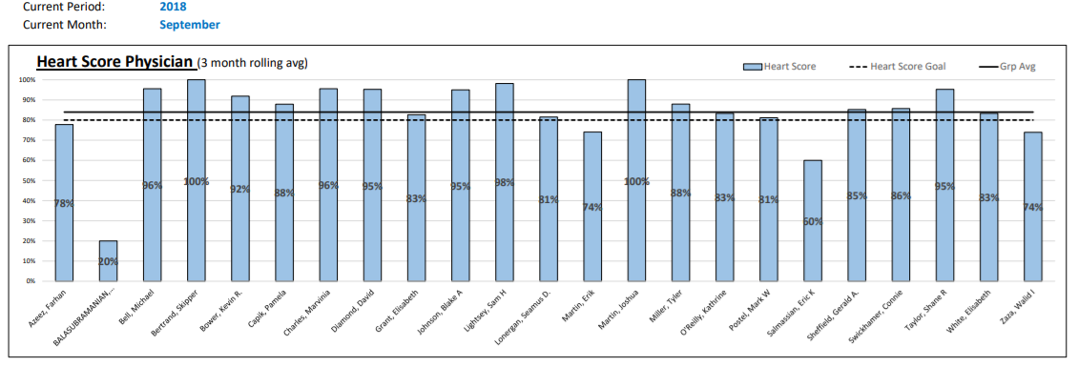
Individual & group performance Risk Stratification Documentation Rate

Slide 6
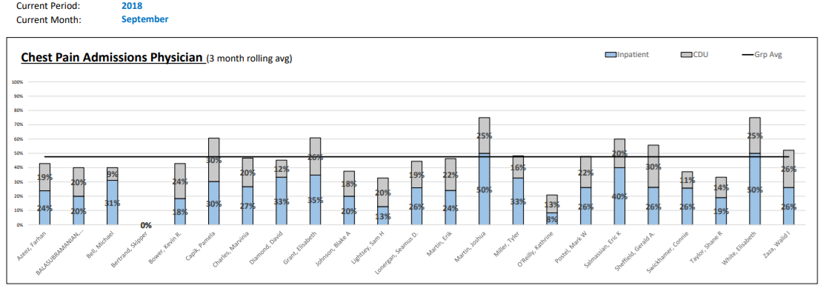
Individual & group performance: Overall Chest Pain Admission Rate

Slide 7
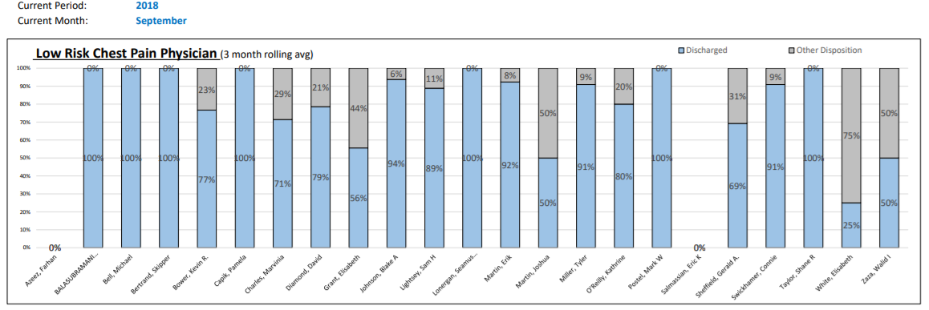
Individual & group performance Low risk chest pain discharge rate

Slide 8
Results
During the 24-month program, 1,456,555 patients were cared for by participating EDs.

Slide 9
Results
Overall admission rate dropped 22.6% (42.6%(SD 0.93) to 33.0%(SD 3.13) p<0.0001).

Slide 10
results
Overall admission rate dropped 22.6% (42.6%(SD 0.93) to 33.0%(SD 3.13) p<0.0001).
Annualized, this reflects prevention of 2,175 admissions to the hospital.
With an estimated total cost of $12,421 per admission, this represents $27,000,000 in avoided inpatient costs.
During this time, there was no increase in referrals for peer review, for missed diagnosis of ACS or readmissions for chest pain.

Slide 11
conclusion
When paired with individual provider feedback and a standardized risk assessment for acute coronary syndrome in patients with chest pain, there is reduction hospital admissions.

