Slide 1
Influencing the Opiate Epidemic:
Reducing Risk Through Emergency Department Prescribing
Robert Risch, MD., MBA, FACEP
John Garrett MD., FACEP

Slide 2
Background
The United States opiate crisis appears to be influenced by opiate prescribing patterns.
Per the Center for Disease Control, 10% of opiate naïve patients who receive an opiate prescription for greater than 7-days will still be using at 3-years.

Slide 3
Background
Emergency Departments (EDs) care for patients with painful conditions and often utilize opiate pain medications.
This likely contributes to the overall burden of opiate exposure in opiate naïve patients.
The aim of the project was to reduce ED opiate prescribing across 10 hospitals through streamlined workflows, education, and individual provider feedback.

Slide 4
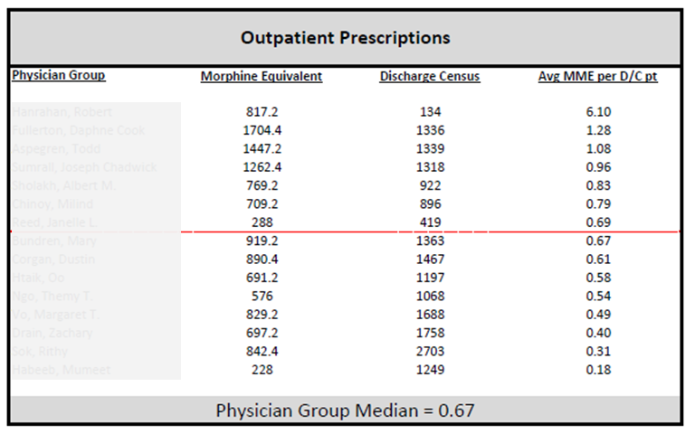
methods
Provider opiate prescribing patterns over a 12-month baseline period were converted to oral morphine milligram equivalents (MME) and normalized by patient volume.
We noted marked variation in prescribing patterns

Slide 5
Methods
Providers received personal and peer prescribing patterns in an unblinded manner

Slide 6
methods
A key component of roll out was the development of a comprehensive educational program highlighting
1) Opiate alternatives
2) Multimodal Therapy
3) Risk stratification for adverse effects
4) Communication with patients developed

Slide 7
methods
The electronic healthcare record prescription writer was updated to default a standard number of pills (12).
Each month individual providers received unblinded 3-monthing rolling data on opiate prescribing. Group opiate prescribing was tracked monthly.

Slide 8
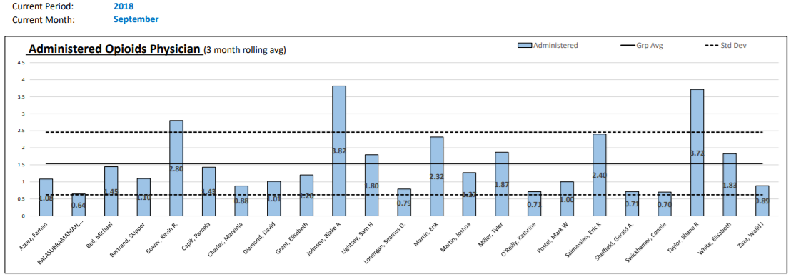
Individual & group performance
Opiate MME Administered in the ED

Slide 9
methods
Pre and post utilizations were compared utilizing descriptive statistics and student’s t-test.

Slide 10
Results
.
Over the 6 months of program roll out 218,000 patients were cared for by participating EDs, while the baseline period included 436,000 patient encounters.

Slide 11
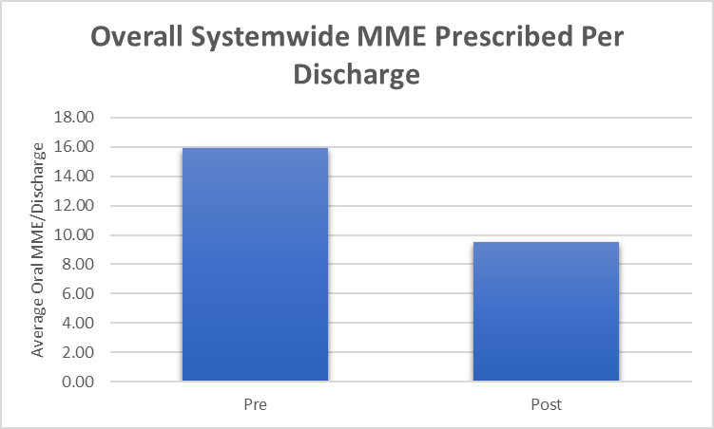
results
Overall opiate use dropped from a baseline of 15.9 (SD 7.3) MME/patient discharged to 9.0 (SD 7.3) MME/patient discharged (p<0.0001).

Slide 12
results
Annualized this reflects a reduction of 122,000 tablets of opiates prescribed through our EDs.

Slide 13
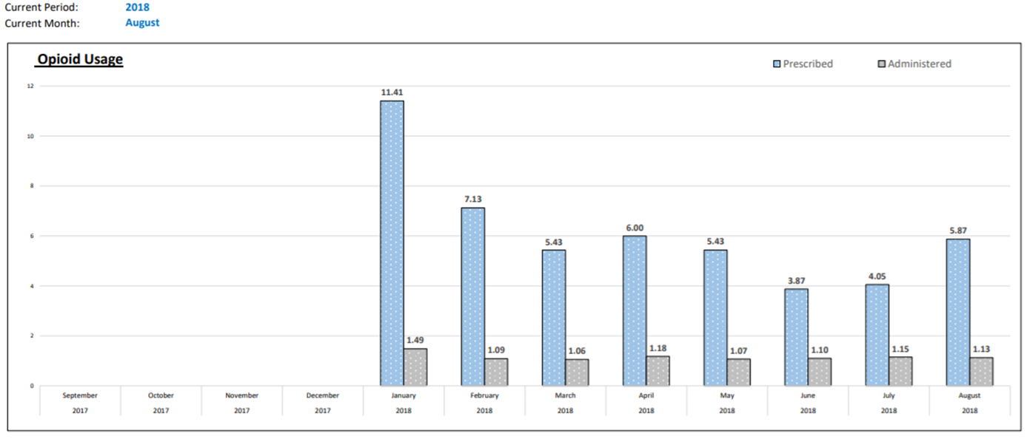
results
There was significant variation in performance amongst hospitals with some reducing opiates by 72% (14.4 (SD 7.2) MME to 4.1 (SD 4.3) MME, p<0.001).

Slide 14
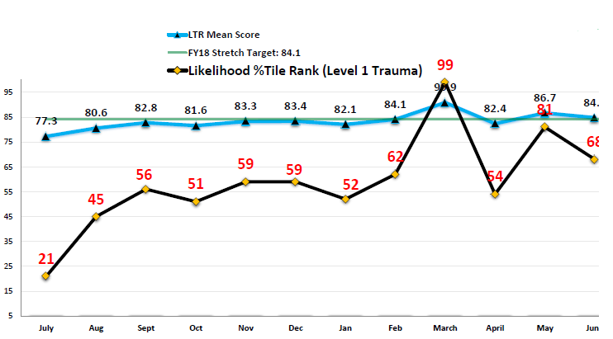
results
Overall patient satisfaction scores increased over the course of the program.

Slide 15
Conclusion
A comprehensive Emergency Department pain management program reduces opiate prescribing.

