Slide 1

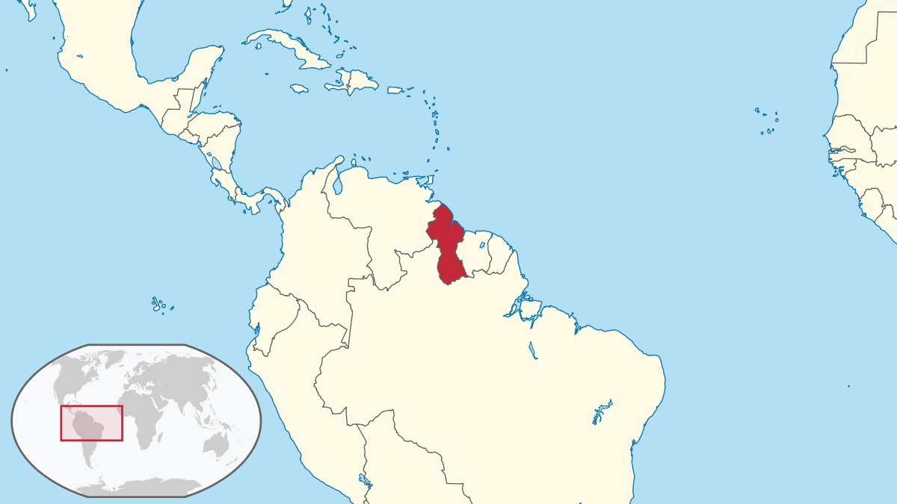
Electrocardiogram Quality Assurance Interpretation in a Developing Country Setting: A Program Pilot
Georgetown Public Hospital Corporation
Rayal Jhagru, MD¹; Joseph M Reardon, MD, DTM&H^{2,3}; Carmen C Wolfe, MD²; Maame Yaa yiadom, MD, mPH, MSCI²
¹Georgetown Public Hospital Corporation; Georgetown, Guyana, South America; ²Vanderbilt University Medical Center; Nashville, Tennessee; ³Greenville Health System, Greenville, South Carolina
SUMMARY
RESULTS
Electrocardiogram (ECG) expert review can be effectively carried out remotely using secure, encrypted commercial smartphone apps.
In this academic emergency department in a moderate resource setting, faculty frequently disagreed with resident ECG interpretations, with 34 out of 69 ECG over-reads having a different diagnosis of probable or major clinical significance.
Remote review of ECGs can serve as a timely tool for ECG interpretation improvement and trainee education.
51% (35/69) [95%CI 34-68%] of ECG interpretations were concordant between resident and faculty interpretations. Discordant results are in Table 1.
36% (25/69) [95%CI 17-55%] of first round faculty reviews were adjudicated by a third faculty member (Table 2).
74% (25/34) of discordant ECG interpretations between trainees and faculty were deemed to be of major clinical significance.15% (3/34) were deemed to be of probable clinical significance.
INTRODUCTION
Challenge | Count | Frequency
Missed non-ST elevation myocardial infarction (NSTEMI) | 10 | 29%
Missed ST elevation myocardial infarction (STEMI) | 7 | 21%
Missed or incorrect heart block | 7 | 21%
Missed or incorrect dysrhythmia | 6 | 18%
Normal ECG (over-call by resident) | 4 | 12%
Inadequate or untimely ECG interpretation is a frequent cause of errors in clinical care in the emergency department.¹
Incorrect ECG interpretation has led to unfavorable patient outcomes, overuse of resources, and prolonged hospital stay.²
Consumer-grade smartphone applications are now capable of transmitting securely encrypted photographs across continents in seconds in a privacy-compliant manner (WhatsApp, Menlo Park, CA).
Georgetown Public Hospital Corporation (GPHC) is the academic, tertiary referral hospital for the country of Guyana, an English-speaking country in South America that is among the poorest countries in the Western hemisphere (Figure 1).
GPHC offers a full complement of residency training programs including an emergency medicine residency program recognized by the Ministry of Health of Guyana. It is an ideal setting for academic quality improvement initiatives.³
Table 1: Discrepancies between trainee and faculty interpretations of ECGs
Challenge | Count | Frequency
Myocardial Ischemia in setting of Tachydysrhythmia | 9 | 36%
Heart Block and/or Myocardial Ischemia | 7 | 28%
Differentiating among (paced or sinus) Tachydysrhythmias | 5 | 20%
Hyperkalemia vs Myocardial Ischemia | 3 | 12%
Left Bundle Branch Block vs Wolfe-Parkinson-White Syndrome | 3 | 12%
Premature complexes vs Pericarditis vs Myocardial Ischemia | 2 | 8%
Non-STEMI Myocardial Ischemia vs STEMI^{b} | 1 | 4%
Table 2: Discrepancies between faculty interpretations of ECGs requiring adjudication by a third faculty member
CONCLUSIONS
Remote review of ECGs using freely available software is feasible for both clinical quality assurance and trainee education.
This remote review mechanism may be most useful for residency programs and emergency departments in remote or resource-poor areas.
High proportion of serious diagnoses including ST-elevation myocardial infarction (STEMI) suggests that residents at GPHC use ECG much more selectively than in the United States, primarily on clinically ill-appearing patients.
Availability of a second and/or third faculty member may improve recognition of subtle cases including ischemia during tachydysrhythmias.
Figure 1: Location of Guyana (Source: Wikipedia, marked for reuse)
METHODS
Residents asked to anonymize and send first 2 ECGs of each shift between October 2017 – February 2018.
ECGs securely transmitted (WhatsApp, Menlo Park, CA) and interpretations stored (Microsoft Excel, Redmond, WA; Box, Redwood City, CA).
Two faculty members independently reviewed ECGs for key findings (rhythm, axis, T waves, ST segments, other key findings), with a third faculty member adjudicating discrepancies.
ECG findings were coded and discrepancies were categorized into three categories – errors without clinical significance (Group 1), errors with probable clinical significance (Group 2), and errors with major clinical significance (Group 3).
REFERENCES
Snoey ER, Housset B, Guyon P, ElHaddad S, Valty J, Hericord P. Analysis of emergency department interpretation of electrocardiograms. Emerg Med J. 1994;11(3):149–153.
Masoudi FA, Magid DJ, Vinson DR, Tricomi AJ, Lyons EE, Crounse L, et al. Implications of the Failure to Identify High-Risk Electrocardiogram Findings for the Quality of Care of Patients With Acute Myocardial Infarction. Results of the Emergency Department Quality in Myocardial Infarction (EDQMI) Study. Circulation. 2006.
Forget NP, Rohde JP, Rambaran N, Rambaran M, Wright SR. Emergency Medicine in Guyana: Lessons from Developing the Country’s First Degree-conferring Residency Program. West J Emerg Med. 2013.
GRANTS: Research reported in this publication was supported by the United States National Institutes of Health’s (NIH) National Center for Advancing Translational Sciences award numbers UL1TR000445, and National Heart Lung and Blood Institute’s (NHLBI) award number K23HL133477. No funding agent was directly involved in the design or conduct of the trial. The content is solely the responsibility of the authors and does not necessarily represent the official views of the National Institutes of Health.

