Slide 1
Implementation of an Emergency Department Transient Ischemic Attack Outpatient Pathway
Kumar Gandhi, MD, MPH
Sanjeev Malik, MD
Christopher Richards, MD, MS
Farzaneh Sorond, MD, PhD
Linda Vaikus, APN
Lydia Van Zalen, BA
Notes:
Thank Audience and ED Operation Study Group
Introduction: Kumar Gandhi 3rd year Emergency Medicine Resident at Northwestern Memorial Hospital in Chicago
Today I’ll be presenting the Implementation of an Emergency Department Transient Ischemic Attack Outpatient Pathway

Slide 2

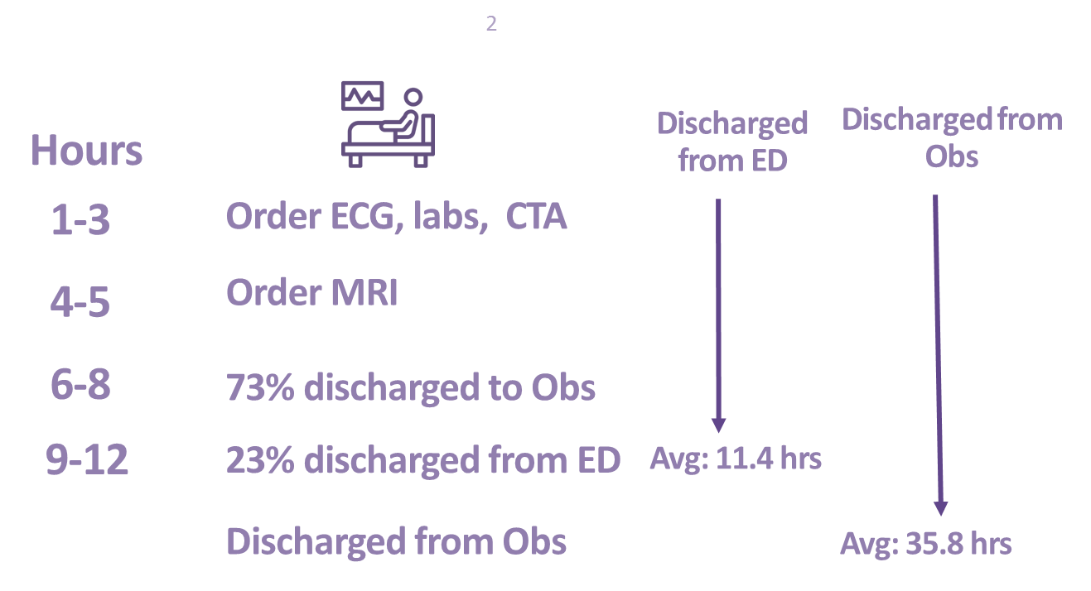


Neuro Spell Pathway Background
The “Why” Behind The Pathway
Additional Capacity
Boarding
Patient Satisfaction
Reduced hospital length of stay
Reduced Cost
Employee Satisfaction
Emergency Medicine
Neurology
Observation Unit Capacity
MRI Resource Utilization
Radiology
Current State
13-36
Notes:
Before I start I just want to highlight we have colloquially termed our pathway the Neuro Spell Pathway at Northwestern and I’ll refer to it as such through out the presentation.
The ”Why” Behind the Pathway
ADDITIONAL CAPAPCITY
First and foremost, as we’re all acutely aware capacity issues and boarding can be detrimental to our practice of emergecy medicine.
At Northwestern our ED is plauged by boarding as the hospital as our EDO Observation Units and inpatient units are often outpacing capacity
PATIENT SATISFACTION (OPEN CURRENT STATE)
Patient receiving neurologic work-ups has ED LOS’s that pushed >11 hours
For over 70% of our patients they were admitted to observation units with LOS’s over 35 hours and the potential for costly stay’s if billed as inpatient encounters.
EMPLOYEE SATISFACTION
For our Nueorlogy colleuges, who particularly felt over-consulted with this population as well as our radiology colleagues who also felt we were outpacing capcity for inpatient MR’s as evidenced by our 4-6 hour MR turnaround time.

Slide 3
Neurologic Patient Volume
Top Diagnosis
Dizziness and giddiness
Headache
Anesthesia of skin
Weakness
Cerebral infarction, unspecified
Transient cerebral ischemic attack, unspecified
Complicated Migraine
Paresthesia of skin
Facial weakness
Unspecified disturbances of skin sensation
Notes:
Our group looked back over a 12 month period by possible presenting diagnosis (which we intentionally kept broad) as evidenced by our top dianosis
- We found over 70% of the time we saw between 0-3 patients with neurologic symptoms daily
- More importantly these patients arrived in the afternoon to evening hours, which typically placed these patient at the bottom of the MRI Quee, as well as during peak hours for the rest our ED and promoted most ED physicians to pursue an observation admission, over 70% of the time.

Slide 4
Neuro Spell Pathway
Evidence and Literature
Notes:
When we reached back to look literature we found a limited number of studies in regards to outpatient management of TIA and Minor Stroke’s. A recent clinical review out of the journal of emergency medicine noted a few prospective studies over that demonstrated:
SHORTER OVERALL LENGTH OF STAYS
LOWER TOTAL DIRECT COSTS
COMPARABLE 90 DAY OUTCOMES

Slide 5
Neuro Spell Pathway
Goals
Goals
Safe
Pathway
Reduce
Length of Stay
Notes:
2 primary goals: When our team came together to create the Neuro Spell pathway it was with 2 Primary Goals in Mind
SAFE outpatient pathway and
REDUCE overall length of stay for these patients

Slide 6
Neuro Spell Pathway
Patient presents to ED with experienced, but not present neuro symptoms
ED MD to call Stroke attending and discuss patient
Pt receives negative EKG/CT/CTA/CXR
Confirm MRI Eligibility
Place patient on pathway, discharged from ED
Neuro Spell Pathway
Physician Referral Services
Registration and Authorization
Nursing
Neurology
Performance Improvement
Radiology
Emergency Medicine
Emergency Department: Place eligible patient on pathway
Neurologic Team places MRI and Stroke Clinic Follow-Up Order
PRS Schedules MRI/Stroke Clinic Follow-up
Pre-Authorization Completed
Patient completes MRI/Stroke Clinic follow-up
Neuro NP to follow up with no-shows/ declined appts
Outpatient Follow Up: Ensure patients receive MRI and Neuro Follow Up
6
Notes:
The Neuro Spell Pathway was the product of interdcilinary team lead by the Departments of Emergency medicine, Neurology, and Radiology.
One group I want to highlight that was pivitiol to pathway success was our physician referall service group who we s in-house from 7AM-7PM and by partnering with them it allowed for their team to take the lead with scheduling MRI and Neurolgic follow-up both whhile in the ED and after discharge.
Neuro Spell Pathway Overview
Our only criteria for patients for this pathway were those that experienced a neurologic symptom within the last 24 hours and were asymptomatic on arrival to the ED and trhoughout their ED course.
We intnetionally broad let our inclusiion crtiera very broad to highlight the breadth of clnical presentation of this patient population as well as recognize the important physician gestallt and empower to our ED physicians to utulzie this pathway when they deemed it appropaite.
The decision to use pathway was also jointly made following a discussion over the phone with the on-call stroke attending/fellow 24/7 and following completion of a stanrdard neruolgic evaluation in the ED though with the icnlsuion of a CTA for vascualr imaging.
Patent’s MRI status was evalauted and if during business hours patient was seen by PRS and left with a scheduled MRI/Stroke clnic follow-up
CLICK
For a larrge majoirty of our patients who presented after busniess hours, they were discharged and in parallel the neurology team ordered the MRI and follow-up as well as our PRS team scheduled the outpatient wok-up while pre-auth for the MRI was completed.
Patient were seen by 5 days through typically scheduled between 24-72 hours post-dscharge

Slide 7
Pathway Results
Jan 16, 2018 – Oct 11, 2018
139 pts, 15 no shows
421 potential patients appropriate for pathway during this period
2 readmissions
0 patients harmed due to the pathway
Four patients diagnosed with Stroke
Two patients diagnosed with Guillain-Barré syndrome
Two patient diagnosed with Multiple Sclerosis
All patients received expedited outpatient workup and did not require hospitalization
55% of pts have received a neurologic diagnosis
Complex Migraine
Transient Ischemic Attack
Neuropathy
Meningioma
Notes:
The Neuro Spell Pathway has now utilized in our ED for the last 10 months and has been a success and met out initial goals as well as a a true practice change for many of our ED physcians.
Over the course of the 10 months 421 patients patients deemed potential candadates for this pathway on chart review.
139 patients were successfully placed on the pathway and we had 15 no shows over the course of the 10 months
From a safety perspective we had zero adverse events, 2 readdmisons, 1 because a patient elected not to wait until her outpatient follow-up appointent and the second because our team could not coordinate an outpatient MRI.
CLICK
Though the pathway was designed for low-risk TIA patients, we anticpated finding stroke. 4 of our patients were found to have MR-confirmed stroke, all of which recived their complete neurolgc work-up with 24-28 hours and non required admission.
We also encouraged pathway utlization for outher neurolight conditons and were able to diagnose two cases of Guillann Barre and multipel slecrosis on outpatient basis again all patients completed their work-up outpatient
Though again the intention was a low-risk TIA work-up a more than half of our patients recneieved new neurolgic diagnoses and were connected to furhter outpatient resoruces.
CLICK
Lastly I nucnluded this to demsontrate we saw patients across various payor mixes, which I believe speaks to how poetnially reporduicble this may be at other instutuions and out in the community.

Slide 8
Neuro Spell Pathway Results
Reduced Length of Stay
ED able to see 138 more pts due to reduced LOS of pts on the pathway
Unpaired T-test for Length of Stay:
CI: -23.5879 to -17.1521
P Value: <0.0001
Notes:
Following implementation of the pathway we were also able to demsontrate a stititically signicant reduction in hospital length of stay from 25 hours for our ED/Obs patients to 5.3 hours for patients placed on the Neuro Spell Pathway.
Given the reduction in length of stay to 5.3 hours our ED additonally was able to see ___ more patients

Slide 9
Neuro Spell Pathway Results
Pathway Utilization
Notes:
This graph demonstrates that prior to pathway implementation we only discharge 10-30% of our patients presenting with hx of neurolgic sxs Which is just at the national average.
Post-implemetation we are now discharging nearly 50% of our patients who presented with neurologic sxs
What am I proud and as a resident was the immense culture change that was required to drive our initial utilization from 14-15% to over 25% and this is a number that continues to climb.

Slide 10
Questions ?

Slide 11
Reference Slides

