Slide 1

Improving Patient Flow through a Centralized Command Center
James Scheulen, Chief Administrative Officer
Emergency Medicine and Capacity Management
Johns Hopkins Medicine

Slide 2

FierceHealthcare:
“The digitized hospital of the future will include clinical command centers and interoperable EHRs”

Slide 3
Deloitte: The hospital of the future
“The digital hospital of the future includes an air traffic-like control system to continually monitor patients and integrate data to chart the “flight paths” of patients.”

Slide 4
Deloitte: The hospital of the future
“In the future, hospitals could have similar command centers (ATC) that equip decision makers with real time support tools to help them make quicker clinical and operational decisions.”
“ATC-like centers already exist ...Why not more broadly at hospitals?”

Slide 5
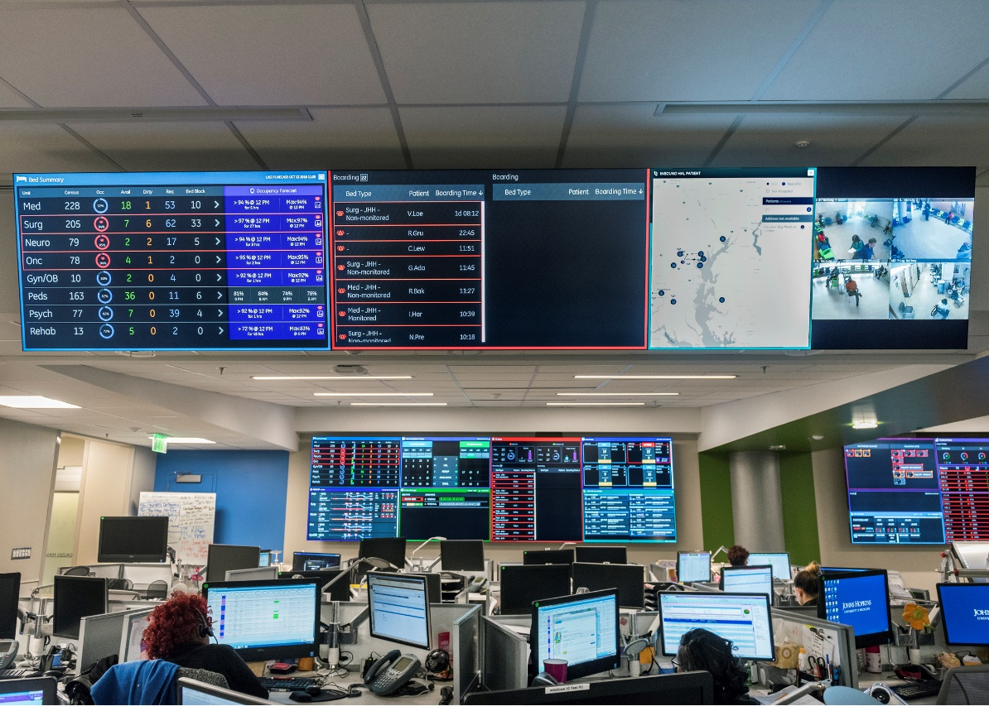
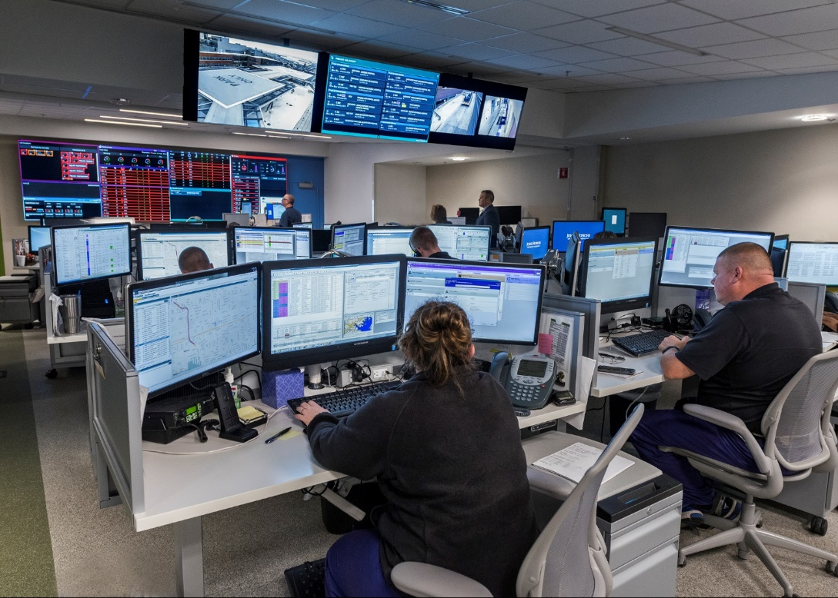

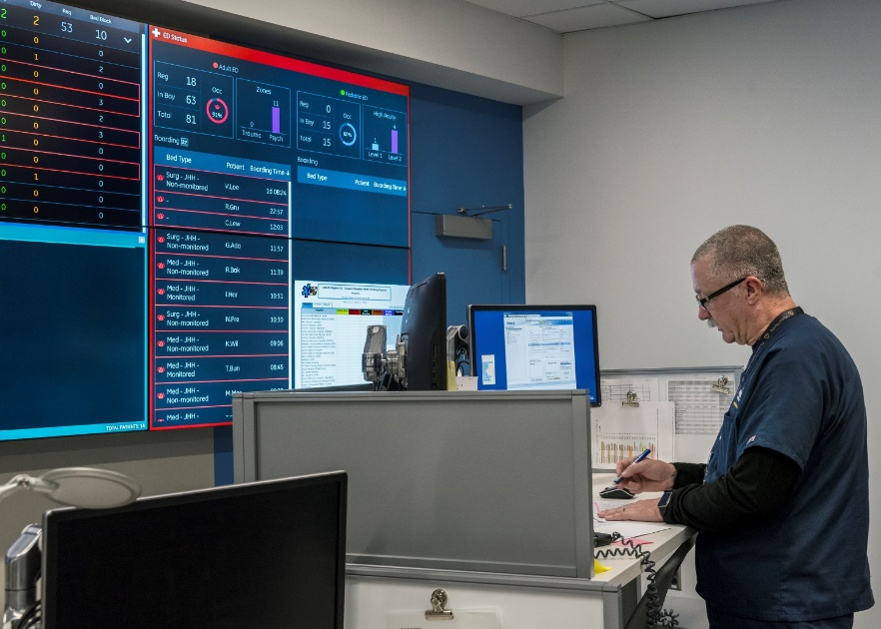
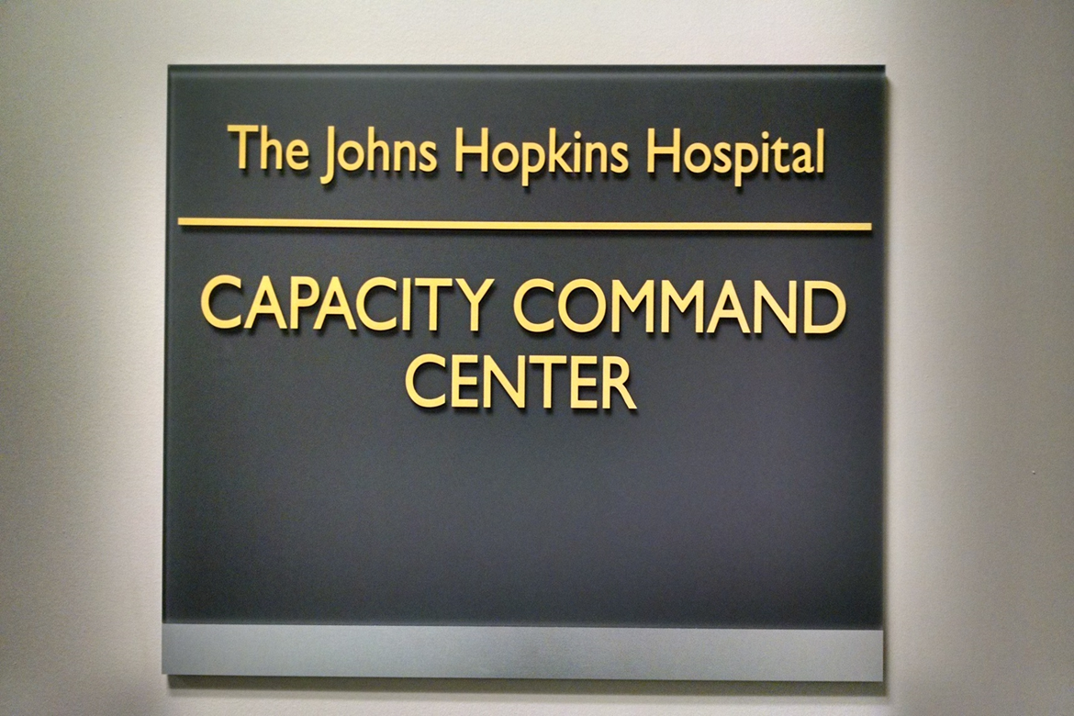
The future is here…

Slide 6

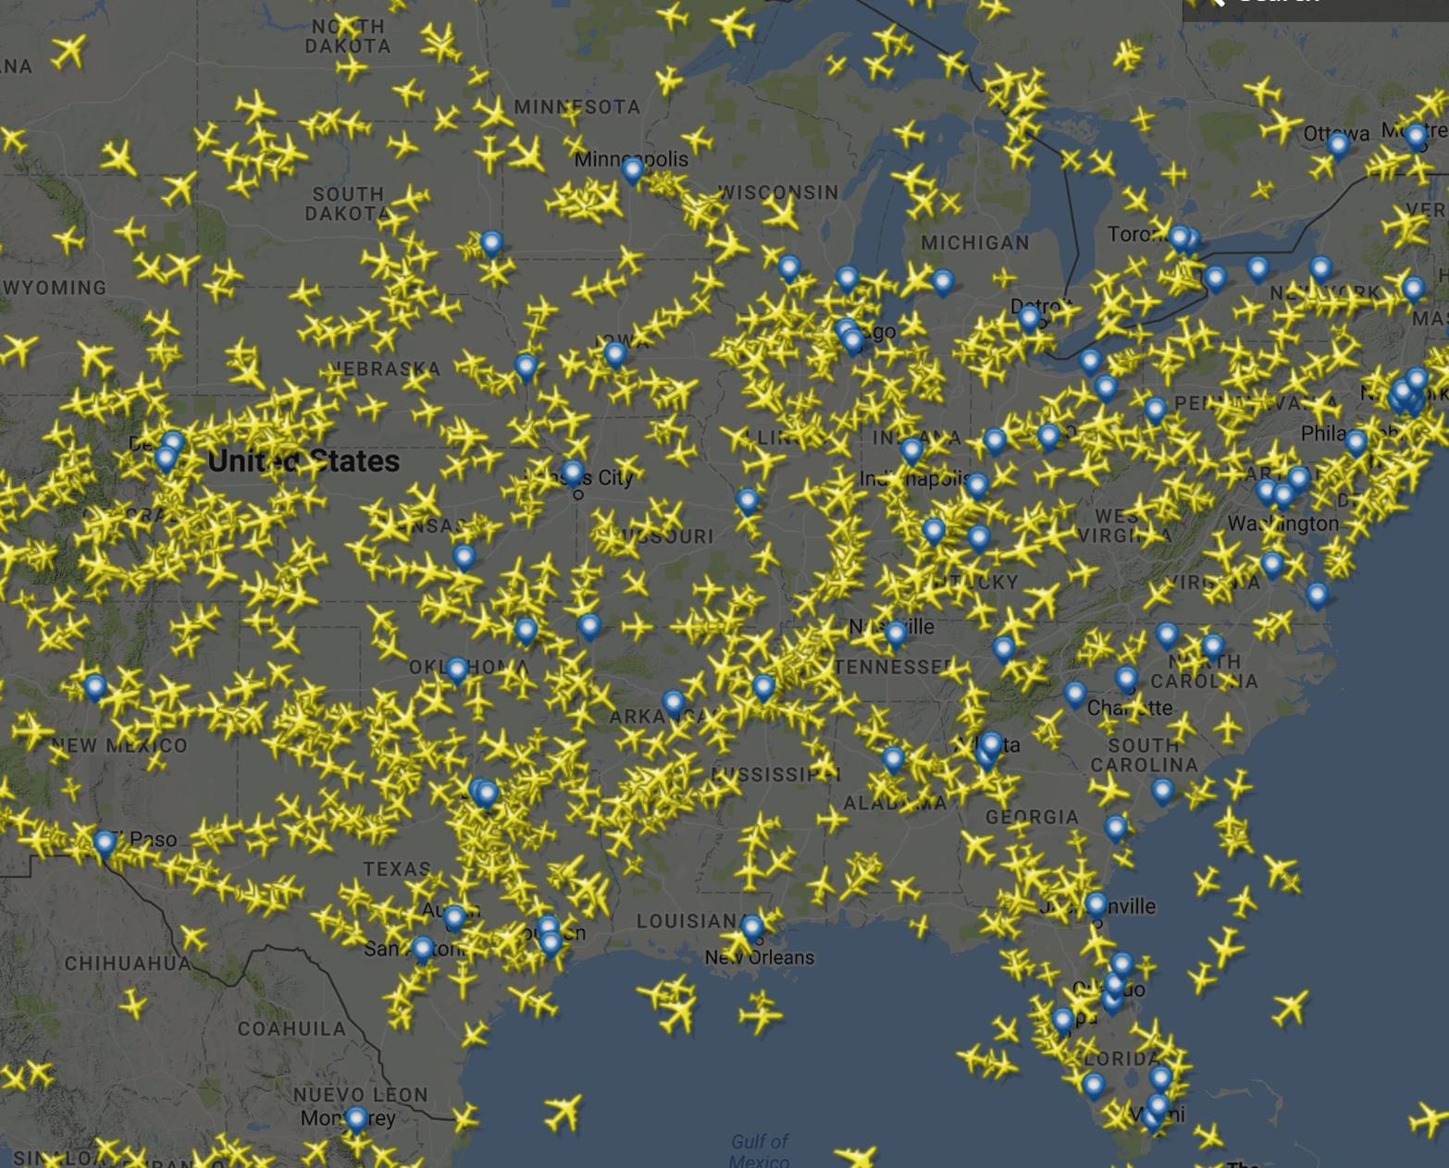

Command Centers
Assume you are a passenger
on any of these airplanes.
Would you:
Want someone managing flow
Trust the pilots to see everything
Assume someone is in charge
Close your eyes and hope for the best
  6

Slide 7


Air Traffic Control vs. Capacity Command Center
Air Traffic Control
Capacity Command
  Fixed airspace
  High utilization
  Arrival/Depart Peaks
  Types of plane
  Pilot compliance
  Emergencies
  Runway capacity
  Fixed inpatient beds
  High occupancy
  Arrival/Depart Peaks
  Types of patients
  Practice variability
  Emergencies
  Hospital capacity
Right plane, right place, right time
Right patient, right bed, right time

Slide 8
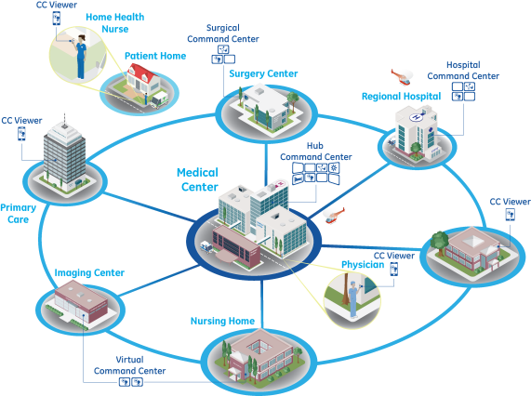
What we know
Current Applications
Future Applications
Patient Flow
Access for high acuity transfers
Proactively plan for growth
Bed Mix
Manage variability real-time
Improve efficiency of care
Quality backstop for the care team
Predict patient LOS
Manage capacity of health systems
Post-acute
Inpatient
Admission
Discharge

Slide 9



Our Discussion Today
Command Center
Active Capacity
Management
Minute by minute
System resources
Volume planning
Systems Engineering
Technology
Process
People

Slide 10

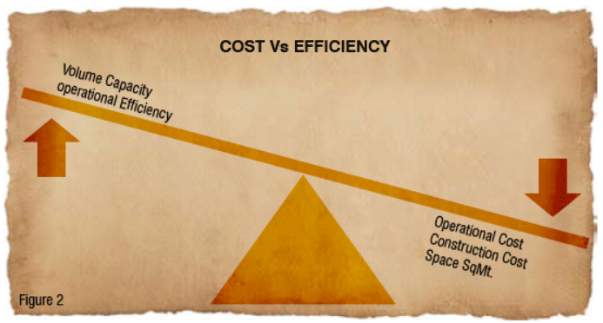

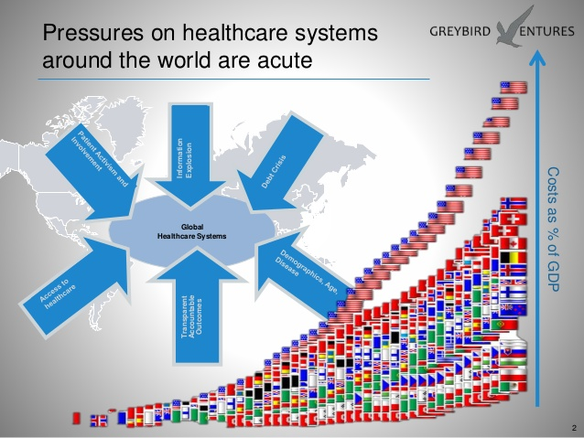
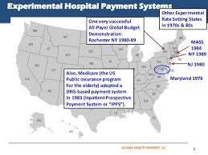
Set the Stage:
Hospital leaders find ourselves having to manage with fewer resources
Hospital leaders find ourselves having to think more critically about efficiency

Slide 11


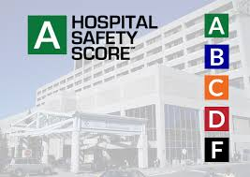




Set the Stage:
Hospital leaders find ourselves thinking about the intersection of quality, safety, outcomes, service and efficiency

Slide 12
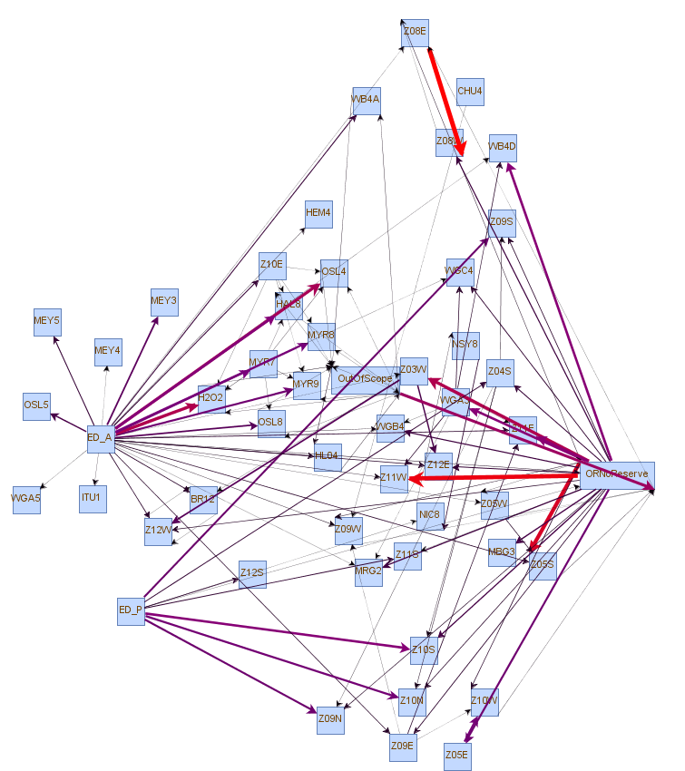


A New Level of Complexity: The Hospital as a System
Definition of a “System”
Inputs
Processes
Outputs
Elements that interact
to produce an outcome
not obtainable by the
elements themselves
Direct Admits from Clinics
Unplanned and require rapid bed assignment
ED Arrivals uncontrollable,
but predictable
Variable Arrivals from Scheduled Procedures
Hopkins Access Line – Need immediate ability to say “yes”

Slide 13





Complex System Operations
Quality
Service
Efficiency
Safety
Outcomes

Slide 14

How Do They Manage?
Optimize the System Using
Systems Engineering & Simulation
Control Centers with Real-time & Predictive Analytics
Requirements
Review &
Feasibility
Analysis
Test
&
Verification
Systems
Engineering
Approach
Platform
Product
Baseline
Comparison
Pilot
Production
Build &
Optimization
Proposed
System
Architecture &
Sub Component
Specifications
Device
Modeling
& System
Simulation

Slide 15
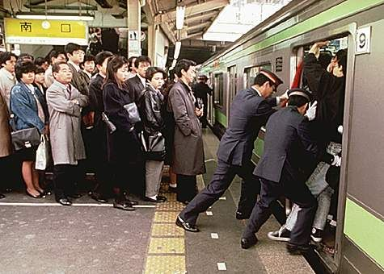
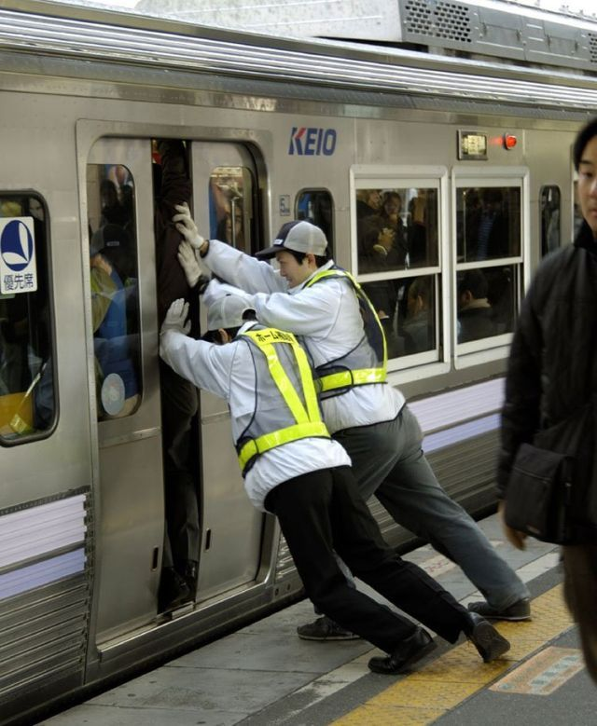
We Are Here Because We Are Busy
Access
Outcomes
ED Boarding
Capacity
Patient
Clinical
Service
Time
Quality
High/Increasing Demand for Fixed Resources

Slide 16

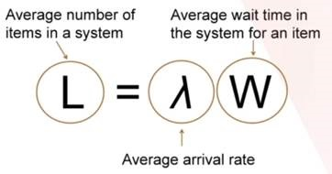
Managing Fixed Resources – The Tipping Point
Queuing Theory: Matching fixed resources with unscheduled demand
Tipping Point
at approximately 85% Utilization

Slide 17
Problems
6.0
Hours of ED Boarding¹
36
OR Holds/week²
55
HAL declines/month³
Peds: 2.8 hr
Address the opportunities while staying true to our goals:
Provide the best care for our patients
Place the right patient in the right bed at the right time
Be good stewards of our resources
Reduce the daily heroics
ED Cases: Jan ‘15 – Apr ‘15, 2. OR Holds: Jan ‘15 – May ‘15 3. Transfers: May ‘13 – Jun ‘14
17

Slide 18
Operational Occupancy
Project Opening
Beds are fully utilized
Nurses are fully utilized
Providers are fully utilized

Slide 19
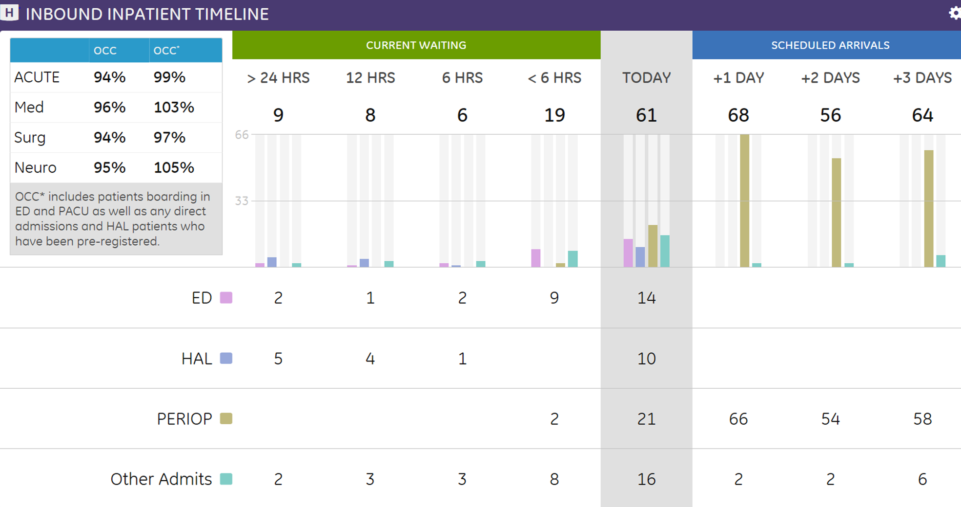
Operational Occupancy

Slide 20

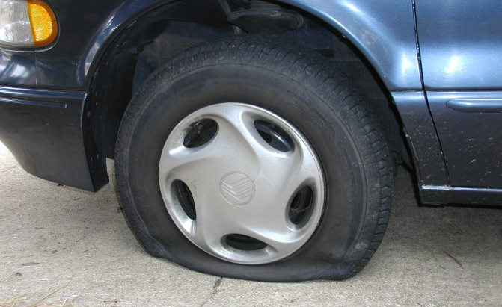
Drivers of Operations
Volume
Time
Space
Must be Balanced
for Efficient Operations

Slide 21
Managing Fixed Resources – The Tipping Point
Inflection point and queuing rate:
  Volume: Number of patients
  Time: Cycle time or Dwell time
  Space: Available service sites
Inflection point and queuing rate:
  Variation/Variability
  Variation/Variability
  Variation/Variability
High Variation
Low Variation

Slide 22

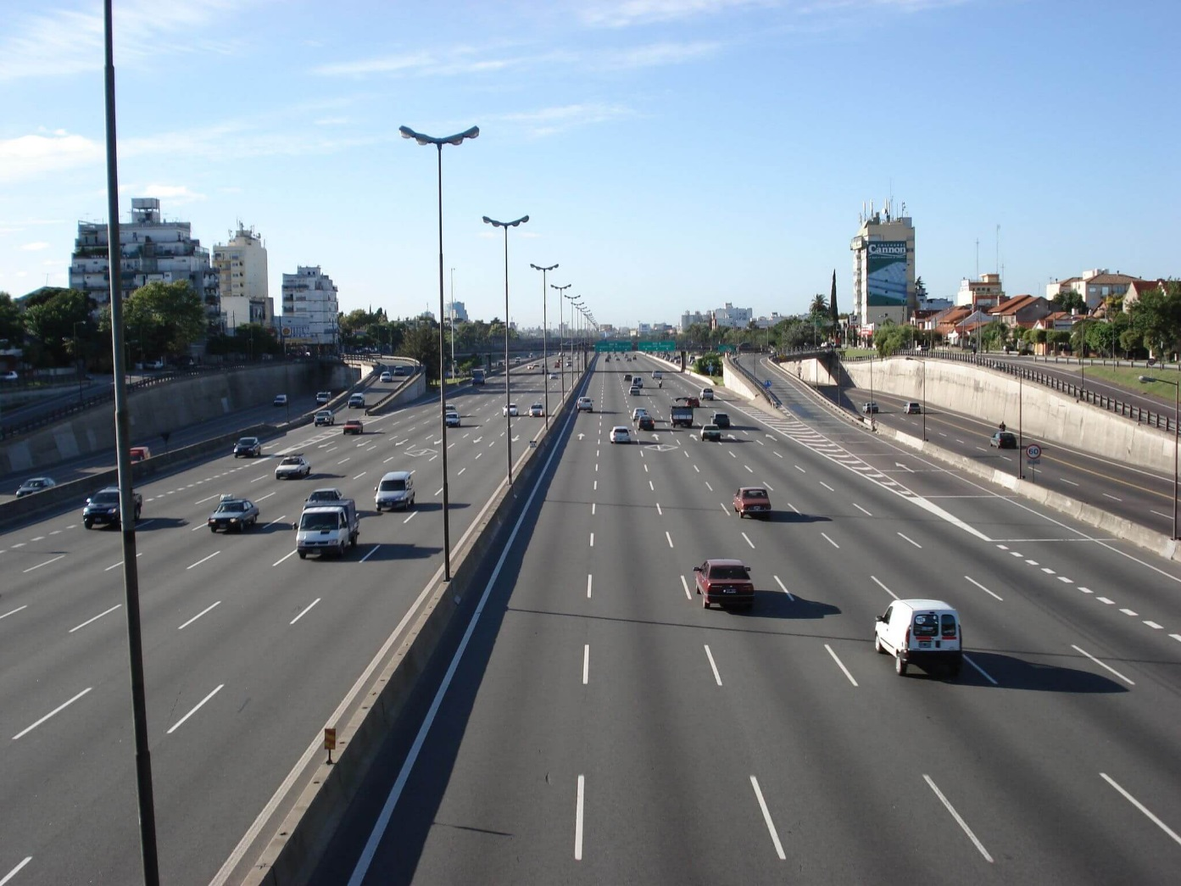
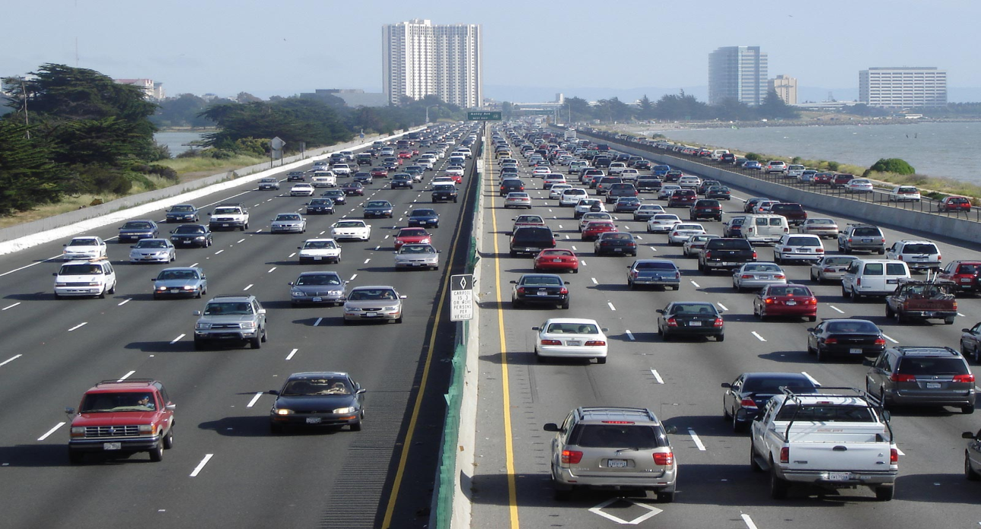
High Occupancy and Complexity – Drivers of Operations

Slide 23

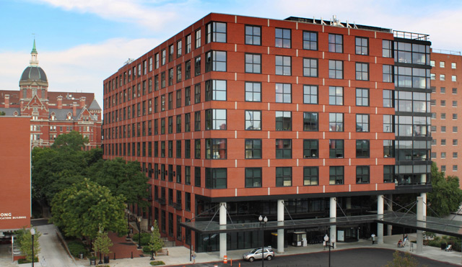

System Operations – Impact of Variability
Production Line
Outpatient Centers
Hospital
Throughput: 182,500 annually
Stations: 8
Cycle time: 26 minutes
Utilization: 99%
No variation in arrivals
No variation in process
Low cycle time
Cycle time variation is minutes
Throughput: 5,840 annually
Providers: 3
Cycle time: 120 minutes
Utilization: 87.5%
90% of arrivals controlled
Replicated process
Medium cycle time
Cycle time variation is hours
Throughput: 50,368 annually
Stations: 1,059
Cycle time: 6.2 days
Utilization: 85%
Arrivals not fully controlled
Complexity not controlled
High cycle time
Cycle time variation is days

Slide 24

Southwest – 25 Minute Turnaround
A successful “System” design
System design
  Parallel processing
  Minimized variation
Aligned incentives
Maximize utilization
 | Turnaround Time | Average Time in the Air | Average Planes per Gate
Southwest | 25 minutes | 11 hours | 10.5
Industry Average | 45 minutes | 8 hours | 4.5

Slide 25

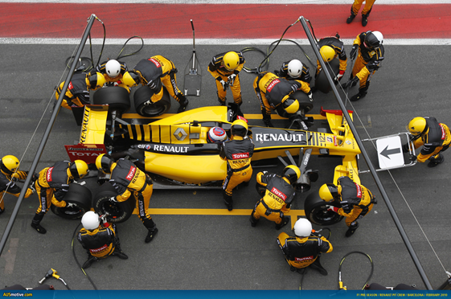
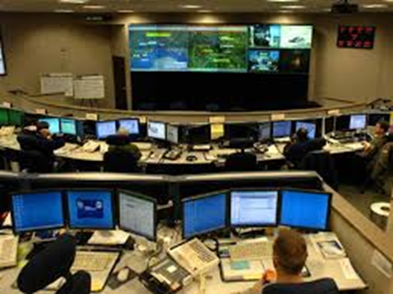

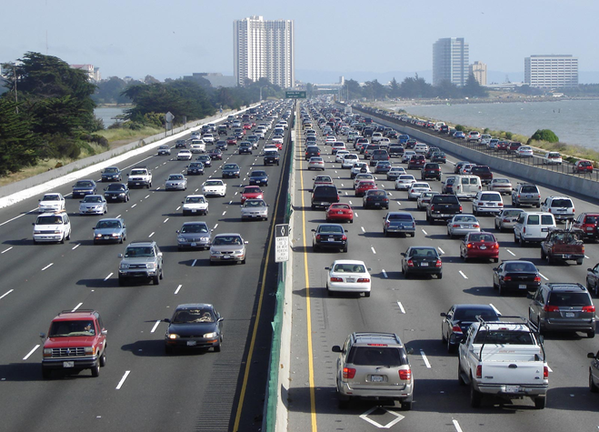
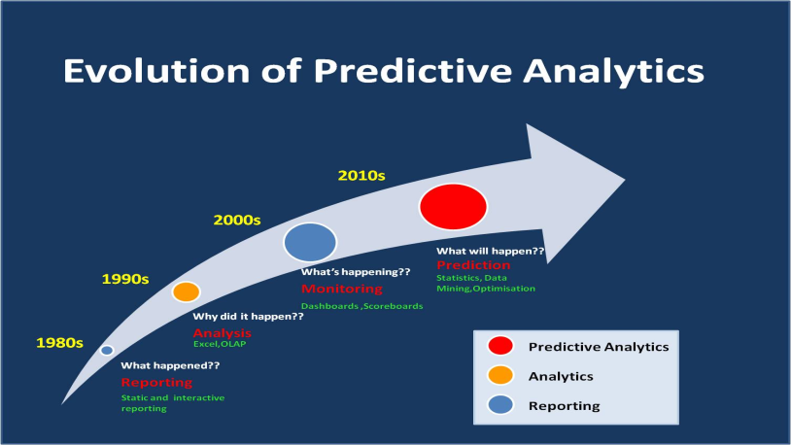
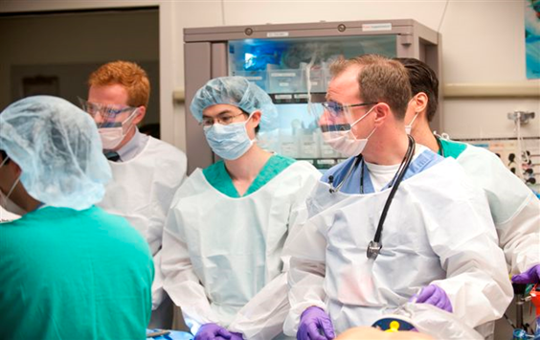
So What???

Slide 26

The Journey
We have seen real improvement
We have learned about our operations
We see the further potential for command center
We have more to do….

Slide 27

Healthcare Command Centers
Breakthrough capability for high-quality efficient patient care
Impact at JHH
  from
  85% →
  Reduced
  35%
  Reduced
  70%
  Reduced
  78%
  93%
  Safe sustainable utilization
  OR “holds” post-surgery
  “Unable to accept out-of-state patients”
  ED patient waiting
Judy Reitz Command Center
The Johns Hopkins Hospital

Slide 28
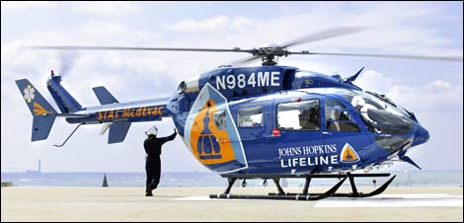
Results: Medic Unit Dispatch
Lifeline medic units are being assigned more quickly for patient transfers
Time to Dispatch
55% reduction

Slide 29
Results: Patient Transfers
Capacity Declines
50% reduction

Slide 30
Results: Time to bed assignment
Surgery
59% reduction
Neuro
80% reduction
Medicine
11% reduction

Slide 31
Results: OR Hold
OR Holds
86% reduction
PACU and ICU Holds
Both number of holds and
Length of hold are down
Developing predictive model
Weekly planning huddle

Slide 32
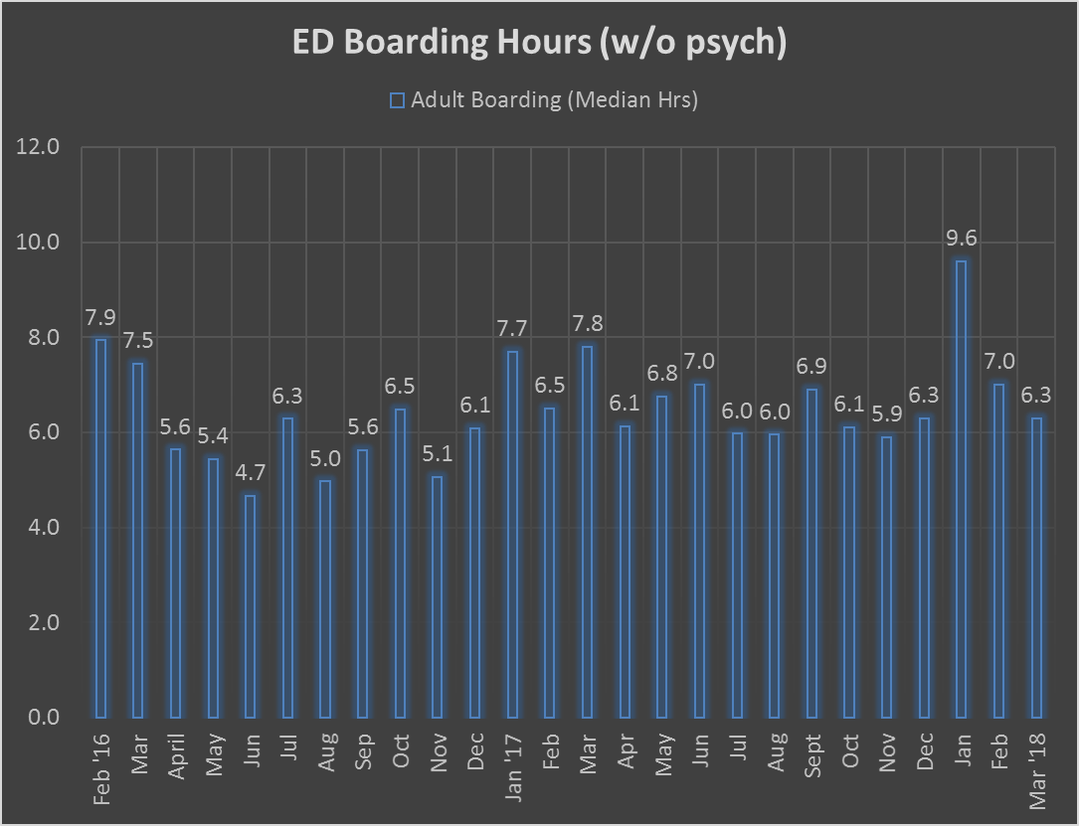
Results: Inpatient Boarding

Slide 33
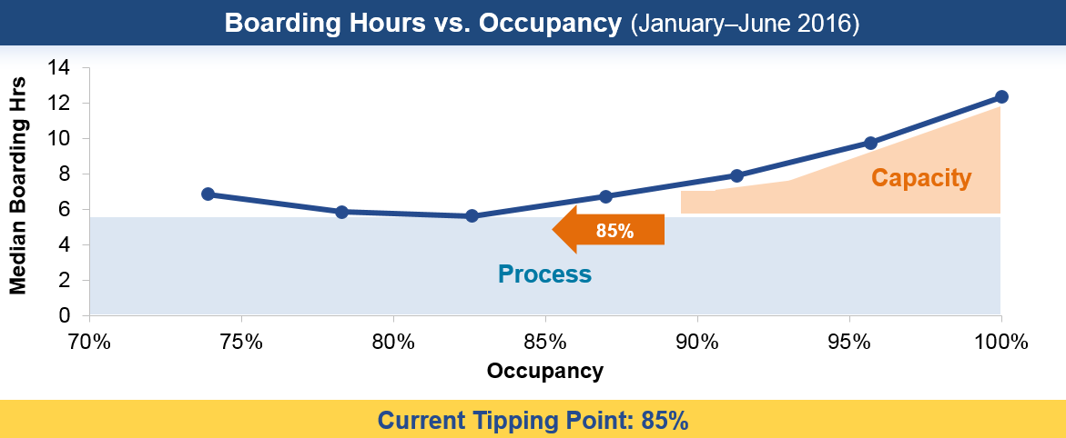
Results: The Queuing Curve Tipping Point

Slide 34
Queuing Curve - The Tipping Point
94%
Increasing tipping point from 86% → 94%, effectively expands capacity by 16 beds.

Slide 35
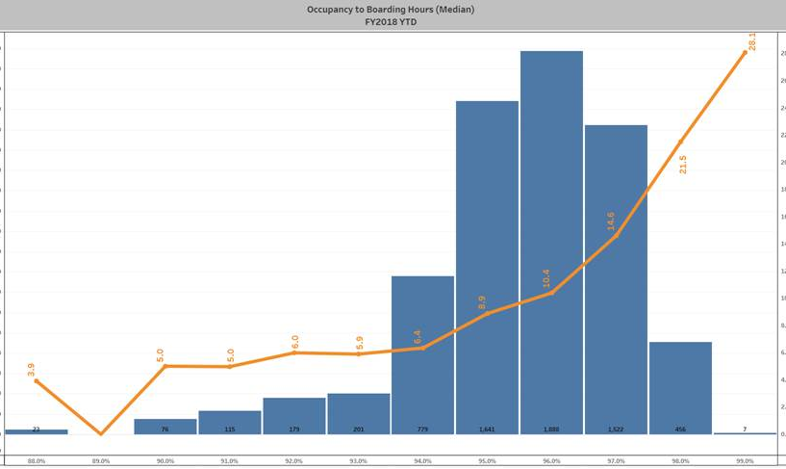
Queuing Curve - The Tipping Point

Slide 36

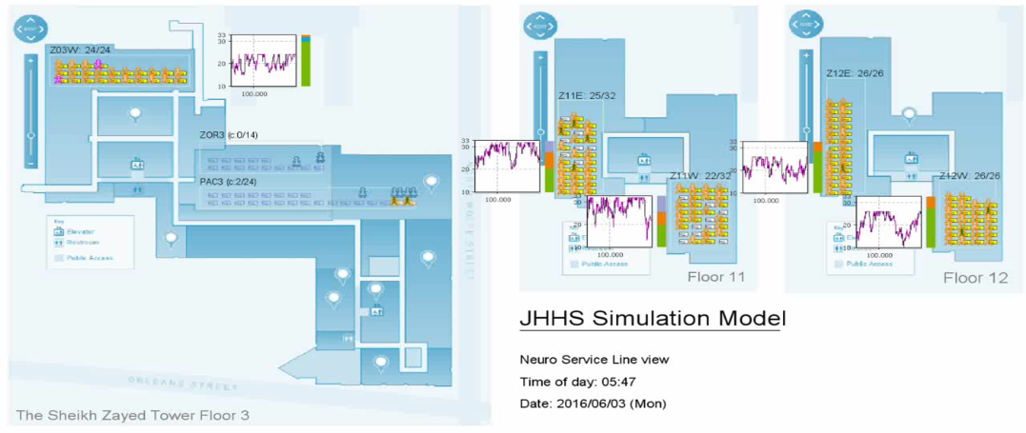
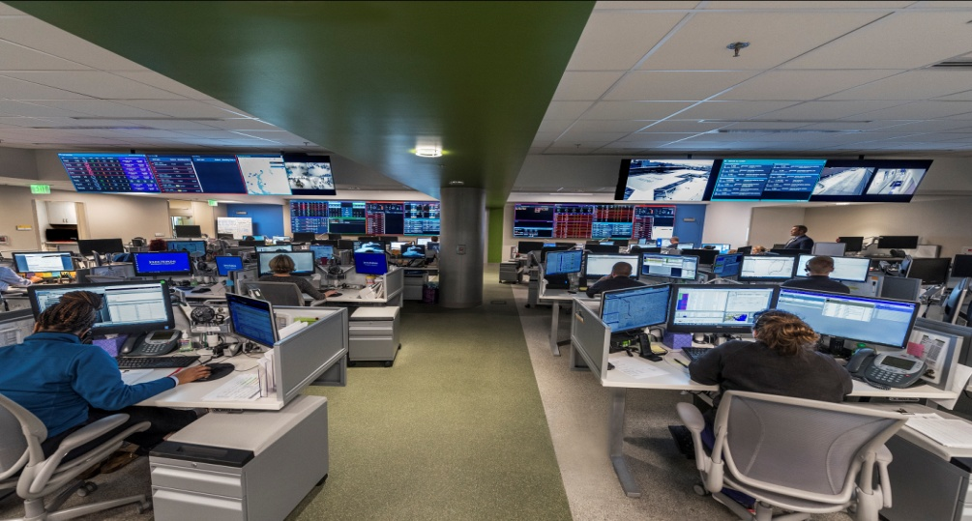
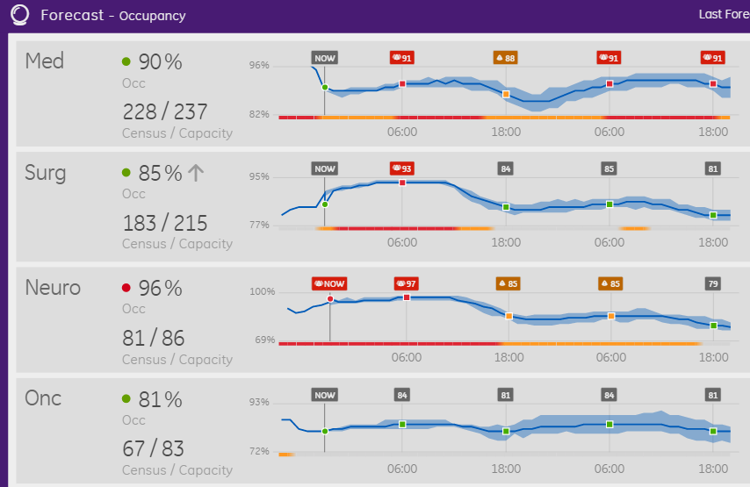
Applying Tools from Other Industries
Systems Engineering
Technology
Process
People
Simulation Modeling
System Design or Redesign
Control Centers
Predictive Analytics

Slide 37
Recipe for success--Technology
Simulation & Advanced Modeling
Command Center
Data Analytics
  Real time data
  Predictive analytics
Systems Engineering
Technology

Slide 38
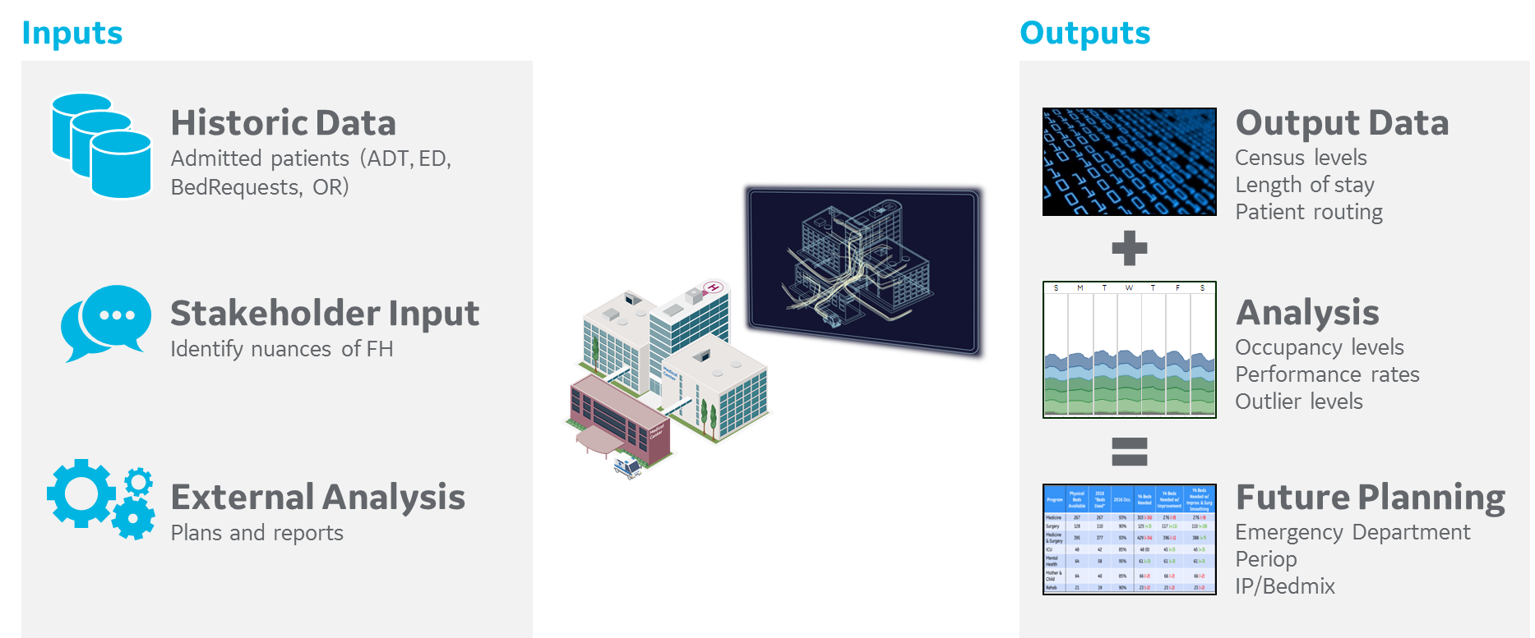
Technology – Simulation Modeling
The Annual Budget Process
Notes:
So, what is the Digital Twin? It is a computerized copy of OHSU. By incorporating a variety of inputs such as historical data, stakeholder experience and external analysis, we can replicate the dynamics and behavior of our system so that we can begin to perform experiments on it. The outputs from the experiments help us to understand the true impact of our proposed solutions, before we implement so that we can feel confident that we are doing work that will move our metrics, ultimately reducing transfer declines, and allowing us to accommodate more of our patients.

Slide 39
Solution Prioritization Matrix
Impact: Compared outputs of various metrics from the simulation model, with high weighting on ED Boarding, OR holds and HAL wait times.
Difficulty: Took into consideration cost, magnitude of change, cultural transformation required and the complexity of the technical solution.
High
A | Elective ICU Capping
B | Pool PACU Capacity
C | Reduce Empty Bed Time
D | ED Process Improvement
E | Reduce PACU LOS
F | Add Monitored Beds
G | Sharing Capacity
H | Fully Staff ICUs
I | Shift OP Volume to JHOC
J | Discharge
K | Reduced LOS
L | Pediatric OBS unit
M | Peds Routing by Age Only
N | Case sequencing within the day
O | Dedicated OP PACU in Weinberg
P | Fully Staff PACU
Q | ESRU
Low
High

Slide 40
Reaching the Capacity Goals
Requires a combination of solutions
Adding additional 12 beds in Adult
(Nelson move) and 4 in Peds
Adding additional 12 beds in Adult
(Nelson move) and 4 in Peds
ED Boarding
⇩ HAL Boarding
ED Boarding
⇩ HAL Boarding
Streamline and Empower patient placement
Streamline and Empower patient placement
ED Boarding
ED Boarding
⇩ HAL Boarding
⇩ PACU Boarding
⇩ HAL Boarding
⇩ PACU Boarding
Conditionally Share Beds
Conditionally Share Beds
ED Boarding
ED Boarding
⇩ HAL Boarding
⇩ PACU Boarding
⇩ HAL Boarding
⇩ PACU Boarding
Streamline ED admission process
ED Boarding
Discharge based on needed supply
ED Boarding
⇩ HAL Boarding
⇩ PACU Boarding
⇩ OR Holds
Fully Staffing WICU to 20 beds
Discharge based on needed supply
⇩ OR Holds
89% patients board in ED < 4 hrs
Capacity to see additional 8 patients in ED
36% reduction in OR holds (55% in WBG OR)
60% reduction in HAL boarding

Slide 41
FY17 Model vs. Actuals
Average Boarding Hours
Model Projected Actual
7.1 hrs 6.9 hrs

Slide 42
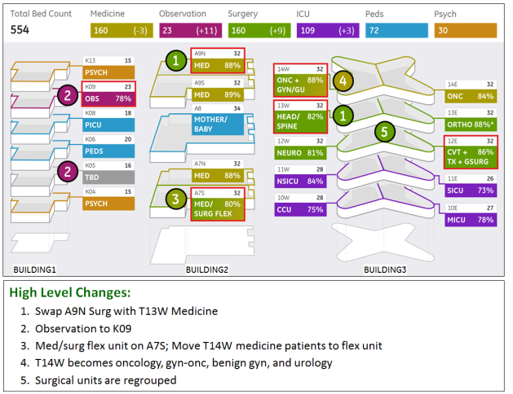
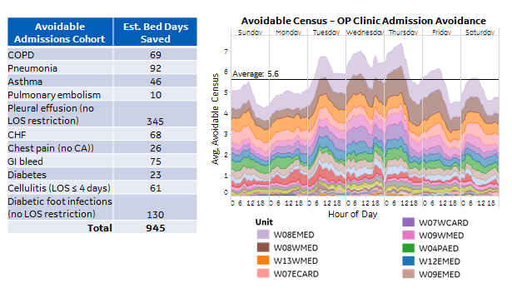
What if?
Optimal bed complement in
future scenarios?
Develop strategy
to improve OP
clinic access
What if we cohort ortho patients differently?
Will growth of Cohort A cause Cohort B to be less localized which in turn increases B’s ALOS and constrains growth of Cohort C? What if we adjust Unit mix? What if we shift Cohort D to outpatient? What about ED patient waiting?

Slide 43

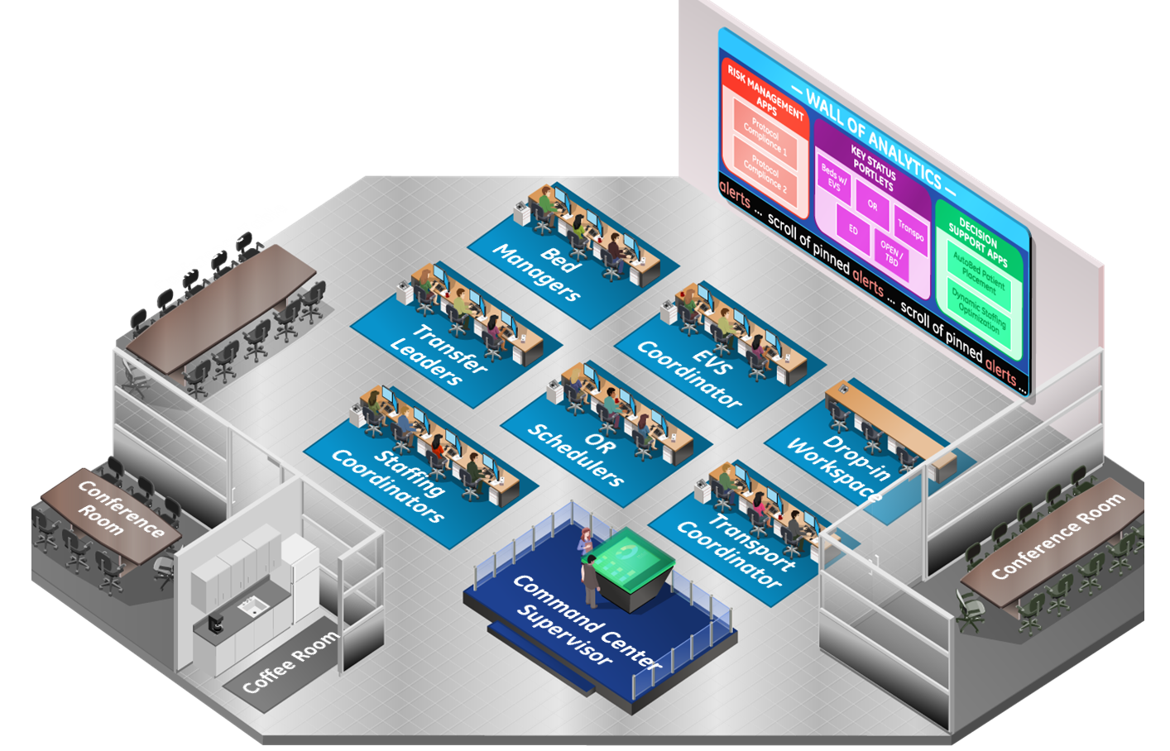
Healthcare Command Center Concept
Real-Time
Predictive Analytics
Co-location of key decision makers

Slide 44

Healthcare Command Center Concept
Hopkins Access Line
Admitting Services
Bed Management Coordinators
Johns Hopkins Lifeline

Slide 45
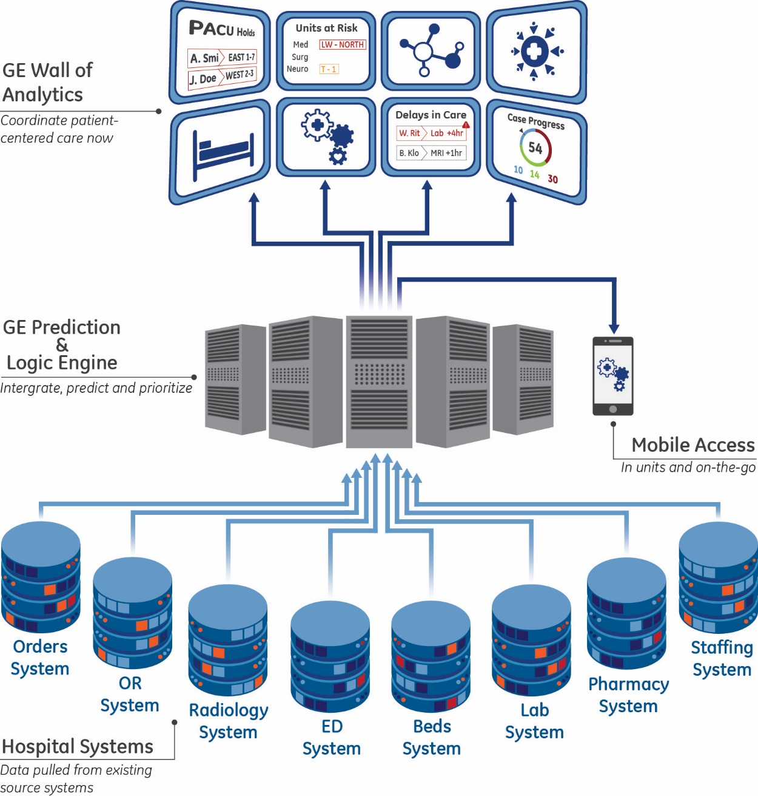
How Does It Work?
Action
Action
Action
Real Time
Real Time

Slide 46
ANALYTICS
Types of Analytics
Situational Awareness
Prescriptive
Predictive

Slide 47
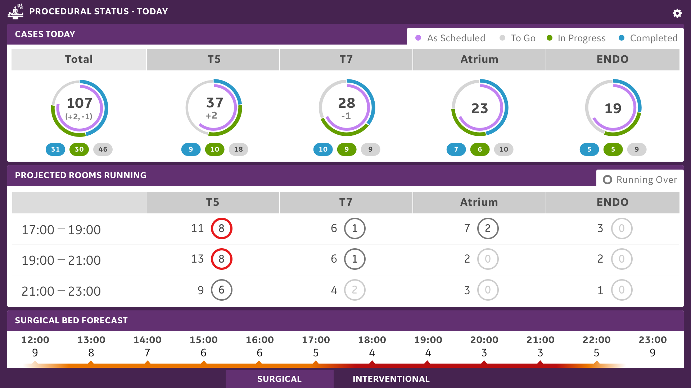
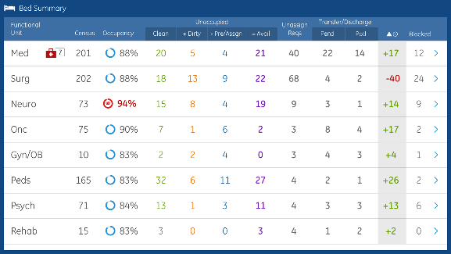
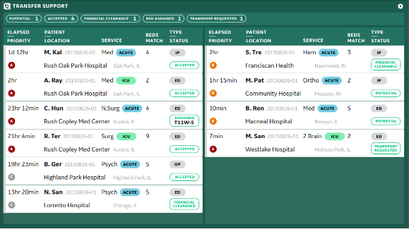
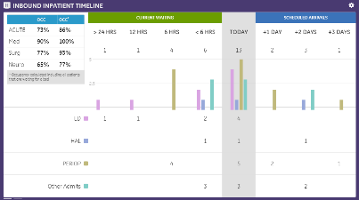
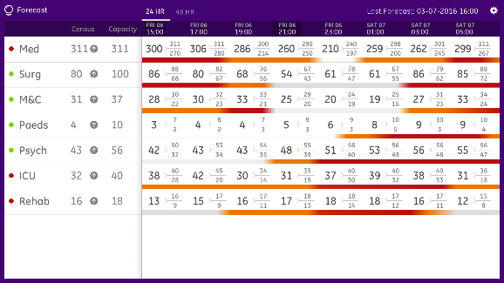
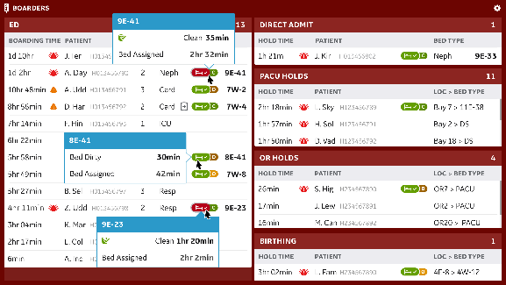
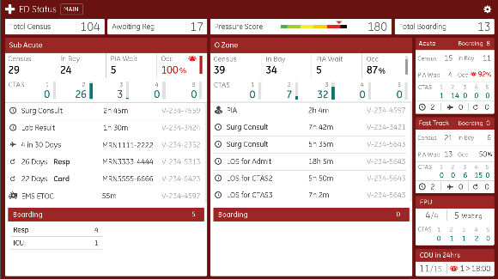
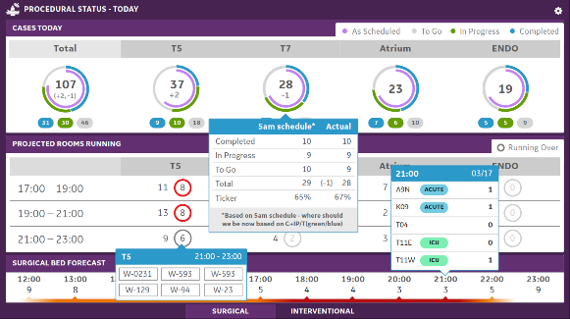
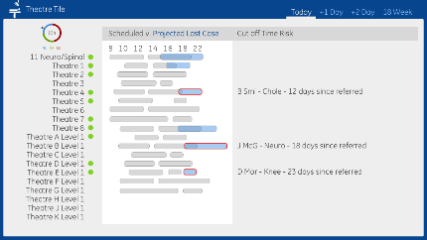
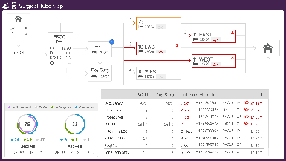
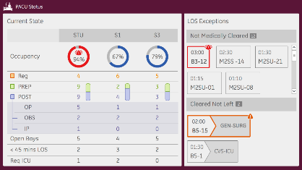
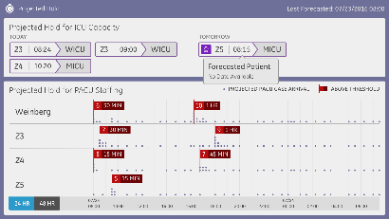
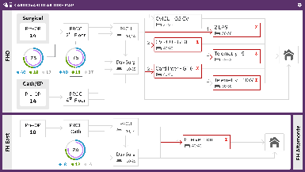
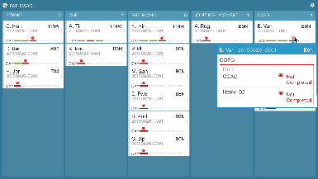
















Suite of Analytics Solving Unique Problems
Access & System Balance
Perioperative flow
Quality and Safety
Discharge and ALOS
Throughput
Notes:
Pre/Assign: Put bed location when WEHA is completed, location will be obtained from OBX from ADT

Slide 48


Slide 49


Slide 50


Slide 51


Slide 52


Slide 53

Sepsis Care
Surveillance of sepsis risk and pathway compliance
Description
Provides caregivers a backstop in the surveillance of sepsis risk and monitoring compliance with defined sepsis bundle protocol. Alerts triggered when patients deviate from the pathway.
Impact
Reduce deterioration in care quality
Improve timeliness of sepsis care

Slide 54
Recipe for success: People
Cultural shift
  Medicine actions
Governance
  During process
  Ongoing structure
Change Management
Systems Engineering
People

Slide 55

Governance
Confidential General Electric Company
Notes:
Intro thoughts?
Governance drives alignment … but also requires alignment (inclusiveness)
Establishing fairness
Reconciling conflicts
Structure establishes a system of checks and balances

Slide 56













Align through massively collaborative design sessions
Design Event
West Coast vMC
Design Event
Midwest Full MC
Design Event
East Coast CC Gen 2
Confidential General Electric Company

Slide 57
Structure: Capacity Optimization (Implementation)
Executive Sponsors
Judy Reitz
Capacity Optimization Steering Committee
(W. Baumgartner, K. Haller, M. Jacobs, R. Miller, S. Reel, J. Reitz, J. Scheulen)
(Meet Monthly)
Project Leadership
Jim Scheulen & Mary Margaret Jacobs
David Efron
Advisory Steering Committee
(M. Anderson, W. Baumgartner, H. Brem, C. Boyne, A. Deutschendorf, J. Efron, G. Kelen, C. Koch, K. Haller, M. Jacobs, J. McArthur, R. Miller, P. Pronovost, C. Reuland, J. Reitz, A. Satin, and J. Scheulen)
(Meet Monthly)
Reports To:
Clinical Admin/DON’s
Management Committee
Capacity Optimization Center Working Group
Chair: Mary Margaret Jacobs
Resource to oversee, predict and aid in patient flow
Capacity Optimization Working Group
Chair: Jim Scheulen
Prioritize operational improvements to change patient flow systemically
Culture Change

Slide 58
Structure: Capacity Optimization (Sustainment)
Capacity Optimization Executive Committee
(R. Peterson, R. Miller, C. Reuland, D. Baker, P. Hill, J. Scheulen, M. Jacobs, D. Efron)
Clinical Directors
Office of Capacity Management
(J. Scheulen, M. Jacobs, D. Efron, E. Kane, L. Huffman, D. Wilson, J.A. Fenstermaker)
Hospital
Oversight of patient flow and capacity optimization;
Strategic capacity plans;
Triage opportunities to functional level as appropriate
Capacity Management Committee
(DONs, Admin, Vice Chairs)
Functional/
Departmental
Functional Units
Leadership
Nursing
DON
Standard of Practice
Cap Ops Committee partners with existing functional & multi-disciplinary teams to conduct deeper dive analysis & problem solving
Care Coordination
Periop
OR Exec
Periop Leadership
ED
COC
CEC
EMOG
Providers
Clinical Directors
Medical Board
Essential Services
*Examples of - committees may not be all inclusive
Command Center
Advisory Steering
Huddles
CC Ops

Slide 59
GE Change Acceleration Process (CAP)
Effectively managing the human side of change
The Key Dynamic:
Q x A³ = E
The effectiveness of the outcome is equal to the quality (Q) of the solution times the acceptance (A) of the solution.
CAP Model
Change Objectives
Leading Change
Acceptance
Alignment
Accountability
Creating a shared need
Shaping a vision
Mobilizing commitment
Making change last
Monitoring progress
Current state
Transition state
Improved state
Systems and Structures

Slide 60
Recipe for success: Process
System design
  Remember Southwest….
Optimize for the system
  Plan for the desired outcome
Break silos
Systems Engineering
Process

Slide 61



Methodologies
Systems Engineering
High Reliability Organization
Change Management
High Reliability Organizations are preoccupied with failure and
design safe systems to keep their patients free from harm
Notes:
Originate – launch program, set timeline
Discover – explore and observe the problem
Focus – articulate goals, scope and principles
Concept – Complete a staff-endorsed design
Design – executable specification
Build
Launch – prepared, rehearsed and phased go-live
Operate – reach and sustain higher level performance
Understand the problem before designing the solution
Fixate on the problem to align leaders and get commitment – start with what is mission critical, make sure we have total alignment and commitment at the leadership/staff level
Then design a transformation program (problems may manifest themselves in similar ways but because each hospital operates differently, they may require a different approach to solving) – some problems can be solved immediately, others cannot

Slide 62












Optimize for the System
Nocturnist evaluates the patient for SOB in the middle of the night and orders treatment
SNF bed becomes available
Enter ED with chief of complaint of SOB (patient with history of CHF)
Sign out is provided to the nocturnist
Nocturnist hands off the patient to one of the teaching teams in the morning
Discharge order is written
Register
Case management and PT assessment
Med rec is performed
Triage
Rounding by the teaching team (intern, resident, hospitalist attending)
Waiting room
Treatment is initiated
Med rec is performed
Discharge paperwork is completed
RN, ED, MD assessments
Admission orders are written, orders are placed
Patient is evaluated by a swing resident
Therapy is administered and PT works with the patient
Patient physically leaves the hospital for SNF
Labs, test ordered and performed
Treatment administered
ED case manager evaluates patient to see if re-admit can be avoided
Patient awaits transfer and gets transferred to a general medicine ward
Housestaff and hospitalist attending communicate with the family
Consultants called and evaluate patient
Patient is re-evaluated by ED MD
Holding orders written by ED MD
Case management helps with disposition plan to SNF
Bed request is placed and assigned

Slide 63
System Design vs Process Improvement
Aligned Discharges
Discharge requires more than an order
Discharge is more than a single process
Need a system design
Write order
earlier in day
Some minor impact but not what we expected…..

Slide 64
System Design vs Process Improvement
Aligned Discharges
ID potential
for D/C:
A Predictive Analytic
Communication
Multi-D Rounds
Patient
Education
D/C work sheet
Physician
Rounding and
Communication
Final required
clinical studies
D/C prescriptions
Transportation
home
Medication
reconciliation
Family
communication
ID of barriers
D/C summary
Write order
earlier in day

Slide 65

System Design vs Process Improvement
Clinical Improvement
Identified as potential discharge

Slide 66

Just the Beginning

Slide 67



Our Vision
System Management
Clinical Care
Care Efficiency
Productivity
Predictive Analytics

Slide 68
Our Vision
System Management
HAL manage JHHS flow
Telemedicine Connection
Clinical Care
Sepsis Score
Clinical Care Protocols
Care Efficiency
Discharge Activity
Staffing
Productivity
Supply tracking
E-Handoffs
Predictive Analytics
LOS
Supply & Demand

Slide 69

Our Approach
Azeem Alhar

Slide 70
Think Big
Set Goals
Shoot High
Be Audacious
Help People Understand
Azeem Alhar

Slide 71
Start Small
“A journey of a thousand miles begins with a single step”
Lao Tzu
“The tactical result of an engagement forms the base for new strategic decisions because victory or defeat in a battle changes the situation to such a degree that no human acumen is able to see beyond the first battle.”
von Moltke, Prussian military strategist
Azeem Alhar

Slide 72
Start Small
“A complex system that works is invariably found to have evolved from a simple system that worked. The inverse proposition also appears to be true: a complex system designed from scratch never works and can never be made to work. You have to start over, beginning with a simple system.”
John Gall, system theorist
Azeem Alhar

Slide 73
Act Now
  The faster you act, the faster you learn
  Take small, quick steps and after each, assess what worked and did not
Azeem Alhar

Slide 74
Thank You

