Slide 1
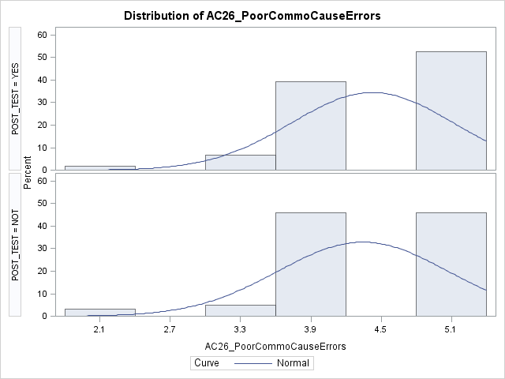
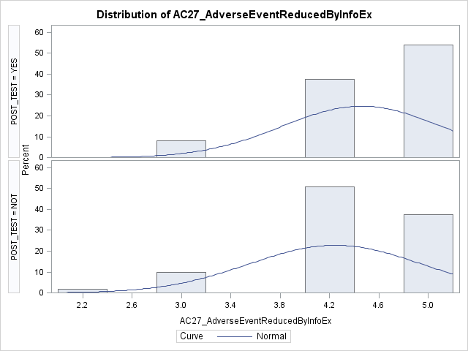
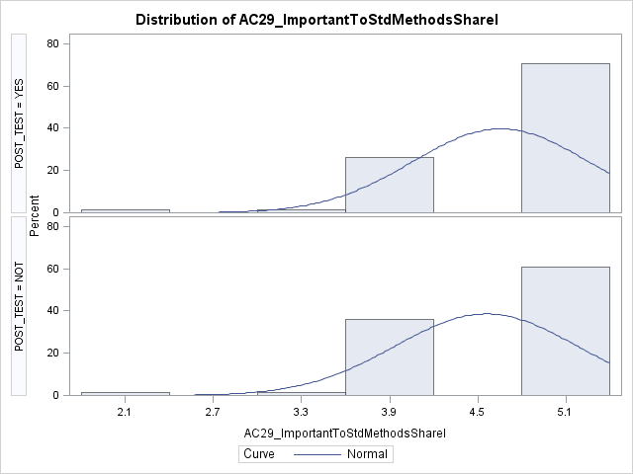
Improving Consults and Interdepartmental and Interdisciplinary Communication in the Emergency Department Joshua McHugh, MD, Jessica Leifer, MD, Shannon McNamara, MD, Eric Ganz, MD, Eric Legome, MD
Introduction
Research concerning ED consultation of specialists is limited but evidence suggests medical consultations are high risk.¹ Suboptimal communication may lead to unclear care plans, delayed disposition and worsened outcomes. Our objective was to develop a collaborative model of consultation between the EM and OB GYN departments, by focusing on interdepartmental communication. We implemented a model using interactive sessions and review for improvement in collaboration and information exchange.
Results
Risk of adverse events were reduced with a responsible exchange of patient information.
Statistically significant change in attitudes and perceptions around using teamwork and communication (p ≤ 0.04), specifically the verbally relay of information to colleagues.
Participants strongly agreed there should be a standardized way of communicating (p ≤0.02).
Discussion
These findings suggest that jointly developing, implementing and reviewing a framework for consultation between services may lead to better understanding of the benefits of standardized communication. Further studies will assess these findings when done with other departments, and metrics showing objective benefits in practice of these models.
Table 1: Pre and posttest attitudes concerning poor communication leading to errors
Methods
Using a modified Delphi process, we presented options for interactive consultation to ED and OB/GYN stakeholders. A standardized process focused on interdisciplinary communication and pre-defined expectations were jointly developed and implemented. Participants (N=61) engaged in a:
Pre-assessment survey: TEAMSTEPPS Teamwork Attitude Questionnaire
Training session on:
Communication
Conflict management
Escalation
Simulated consultation
Post-assessment survey
Limitations
The study was unable to evaluate objective safety or flow metrics. Initial plans were to evaluate these metrics. We expected to improve them with better communication (e.g. LOS), however, an intervening EMR changeover skewed the collection data.
Table 2: Pre and posttest attitues concerning adverse events reduced by information exchange
References
¹Schuur J, Tibbles C. “Risks Associated with Specialty Consultation in the Emergency Department.” CRICO/RMF FORUM: Consults and Patient Safety. 2009;27(2):4-5.
²TeamSTEPPS 2.0. Content last reviewed October 2018. Agency for Healthcare Research and Quality, Rockville, MD. http://www.ahrq.gov/teamstepps/instructor/index.html
³Teamwork Attitudes Questionnaire (T-TAQ). Content last reviewed April 2017. Agency for Healthcare Research and Quality, Rockville, MD. http://www.ahrq.gov/teamstepps/instructor/reference/teamattitude.html
Table 3: Pre and posttest attitudes concerning standardizing methods of communicating patient information.
As special thank you to the EM and OBGYN residents, physician assistants and attending emergency medicine physicians who participated in this study. A very special thank you to Dr. Felicia Hercules and Mr. George Loo, who were instrumental in the performance and analysis of this study.
Key: “Post_Test = Not” = Pretest
“Post_Test = Yes” = Posttest

