Slide 1
Implementing Evidence-Based Medicine into ED System Practice
Robert M. Risch, MD, MBA, FACEP
IES Chief Quality Officer,
Medical Director and Chief
Department of Emergency Medicine
Baylor Scott & White Health at Grapevine
Rrisch@IES.healthcare

Slide 2
NO Financial Disclosures

Slide 3
Objectives
To discuss the operational frame work for best practice implementation into a system of acute care.
To identify potential programs for best practice implementation
To demonstrate the impact of coordinated process improvement.

Slide 4
Good to great
“Good is the enemy of great. And that is one of the key reasons why we have so little that becomes great. We don't have great schools, principally because we have good schools. We don't have great government, principally because we have good government. Few people attain great lives, in large part because, it is just so easy to settle for a good life.”
― Jim Collins, Good to Great: Why Some Companies Make the Leap... and Others Don't
Notes:
Many of our clinicians are good. How many are great?

Slide 5

The Healthcare Value Equation
Create a practice environment that allows providers to work at the top of their license in a collaborative environment using data analytics, operational insights, and creating aligned incentives.
Our operational approach blends staffing of Emergency Departments, Urgent Cares, and Observation Units to deliver the right care at the right time.
Efficient staffing, resource utilization and clinical protocols prevent unnecessary care and associated costs for patients, hospitals, and payors.
Notes:
Emphasize slide – need for value

Slide 6
Reducing Non-Beneficial Variation
Different Treatments
Different Dispositions
Different Cost
Different Satisfaction

Slide 7


Why Now?
First IOM report in 1999
Estimated 44,000 – 98,000 deaths annually from adverse events
Well documented, massive practice variation
High rates of inappropriate care
Unacceptable rates of preventable care-related injury and death
Striking inability to “do what we know works”
Huge waste, spiraling prices, limited access
Personal image of Robert Risch, MD
Personal image of Robert Risch, MD
Notes:
Medical Errors
Cost - “80% of health care costs are directed by physicians. “ In Health Affairs, Mark Smith MD, MBA
Value Based Purchasing
Burn Out

Slide 8

Getting Started In Your Group
In the beginning
Program selection – low hanging fruit
Consensus – how will you decide?
Communication – in person, on web sites, on apps, at educational events, feedback on metrics.

Slide 9

Quality program hierarchy of needs
Define
Measure
Analyze
Improve
Control
Quality Culture
Collaboration
Limited practice variation
Best Practice/Data
Peer Review/Core Measures
Emergency Medicine Training / Fully Staffed
бσ
Level of staff participation

Slide 10
Before You Embark On This Institutional Or System Quality Program
The First Question For You……
ARE YOU WILLING TO MAKE SACRIFICE?

Slide 11
reality
Do you really have basic staffing and training?
Do you have staff engagement?
Be prepared to start at the right level based on reality.

Slide 12
How to start in quality?
Identify a project.
Research best practice, don’t re-invent the wheel.
Use a process improvement methodology.
Ask for help!

Slide 13
Example: Blood Culture Contamination
Problem – rate is too high at 5%.
Goal – less than 1% national standard.
Causes – identified of not following the process; too many different personnel.
What can you do to help?

Slide 14
Blood Culture Contaminants

Slide 15

Taking it to the next level

Slide 16


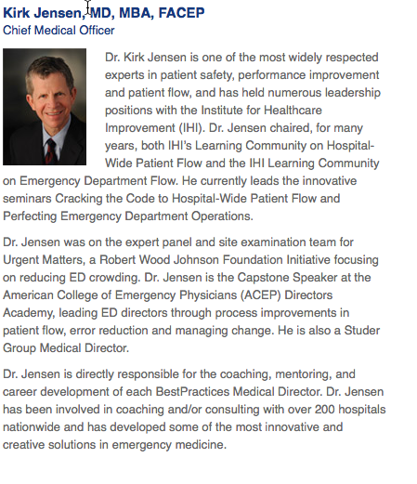
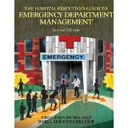

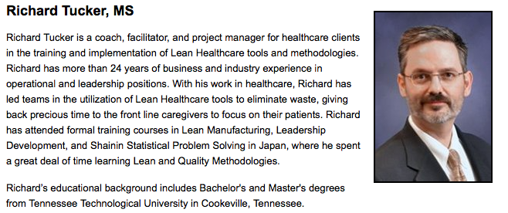
GET HELP
Personal images of Robert Risch, MD

Slide 17
infrastructure
Process Improvement Methodology
Pay for Performance – Volume and Quality
Leadership
Aligned Incentives
Agreement on Evidence based medicine
Quality Group Design

Slide 18
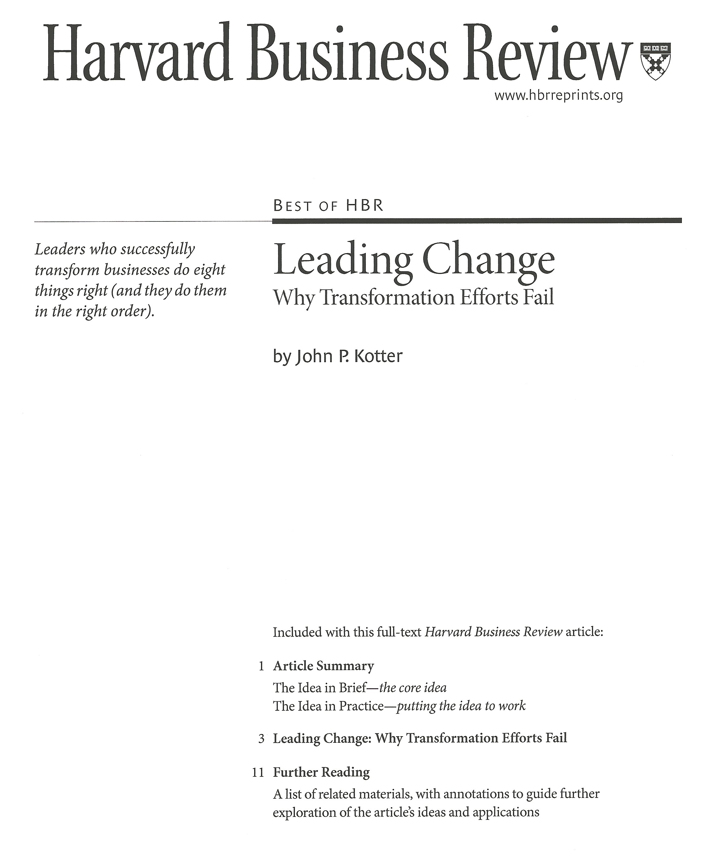
How Do You Change Your Organization?
Develop a Sense Of Urgency.
Forming a Powerful Guiding Coalition.
Creating a Vision.
Communicating the Vision.
Empowering Others To Act On the Vision.
Planning For and Creating Short- Term Wins.
Consolidating Improvements and Producing Still More Change.
Institutionalizing New Approaches.
Personal image of Robert Risch, MD

Slide 19
Quality Program Identification
Home Grown
  Build your own
  A Top-Five List for Emergency Medicine : A Pilot Project to Improve the Value of Emergency Care. Jeremiah D. Schuur, MD, MHS; Dylan P. Carney, MS; Everett T. Lyn, MD; Ali S. Raja, MD, MBA, MPH; John A. Michael, MD, FRCPC; Nicholas G. Ross, MD, MS; Arjun K. Venkatesh, MD, MBA JAMA Intern Med. 2014 Apr;174(4):509-15.
Equal
CEDR
Choosing Wisely

Slide 20
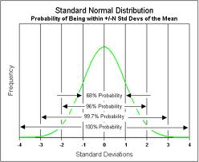
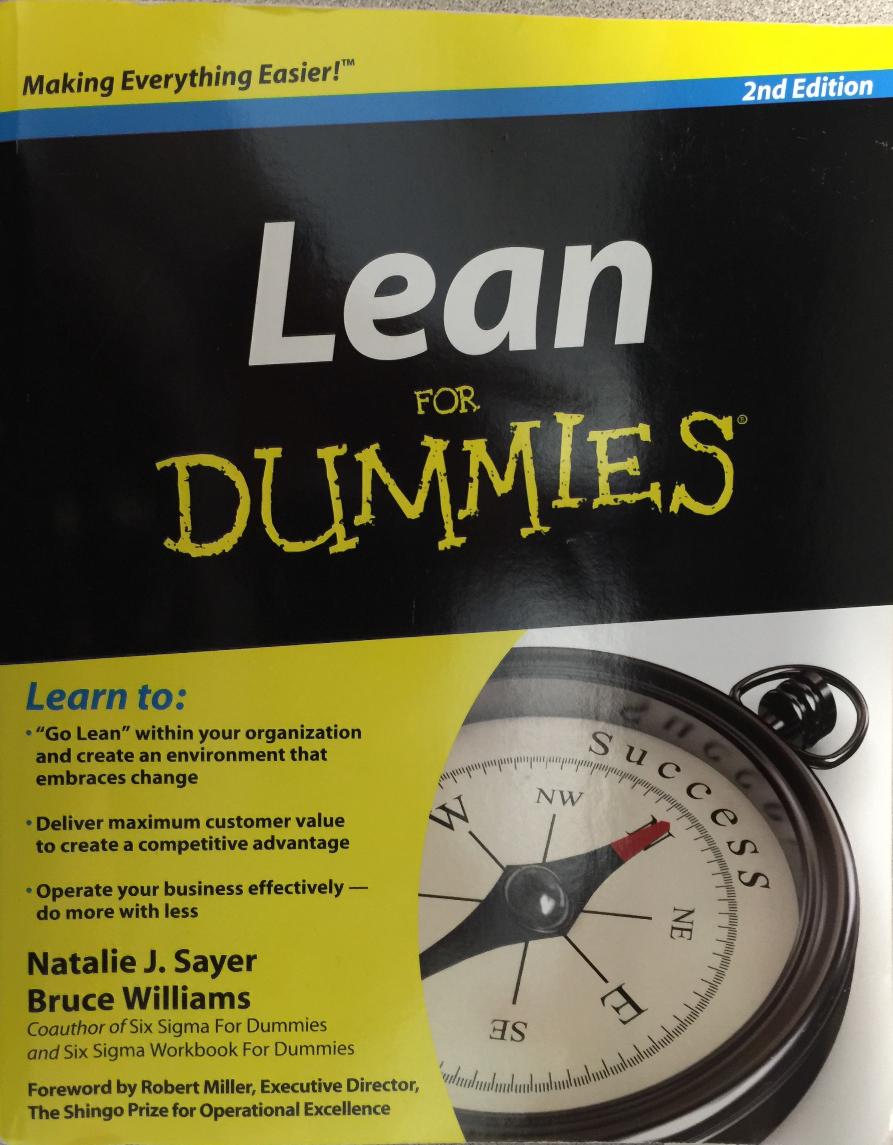
Quality Program Tools
Lean – eliminates waste
6-Sigma – eliminates variation
ISO – 9000 - sets a standard way of creating a quality program
National Organizations
Specialty Organizations
AMA - Physician Consortium for Performance Improvement www.AMA.org
NQF – www.qualityforum.org
AHRQ – www.AHRQ.gov
CMS – CMS.gov
IHI - IHI.org
Personal images of Robert Risch, MD

Slide 21
incentives
May require changes to contracts.
May require changes in work flow.
Will require aligning incentives with desired outcomes.

Slide 22
Identify opportunities for improvement
Collaborate with other departments
Identify measurable goals
Pilot Program
Create buy in - EMQP
Educate
EHR adjustments
Program Roll out
Align Incentives - QSP
Measure improvements
Give feedback - metrics
Make modifications
Steps for improvements
Identify opportunities for improvement
Collaborate with other departments
Identify measurable goals
Pilot the program
Create buy-in – EMQP
Educate
EHR adjustments
Program roll-out
Align incentives – QSP
Measure improvements
Give feedback – metrics
Make modifications

Slide 23
Leadership………
Why me?
Everyone in the room is a leader
This takes a village
Need support from the top down
“Somebody has to do something and it is just incredibly pathetic it has to be us”
  Jerry Garcia
Personal images of Robert Risch, MD

Slide 24
Group Design And Decision Making
Need representation
Need to decided about voting
Need to agree to use evidence based best practice available and expert opinion when needed

Slide 25
Communicate
Studer’s 9 Principles Of Success
Communicate at all levels
  Region
  System
  Hospital
  Website
  Newsletters
  Meetings

Slide 26
Event | Topic / Lectures | Date
EMTALA Symposium | Emergency Medical Treatment and Labor Act | October 2013
1st Annual Quality Summit | Neurological Evaluation Focused on Posterior Circulation, Syncope & CT Scans Treatment of Headache & Chronic Pain End Tidal C02 Patterns & Usage Lactate in Sepsis Have I successfully resuscitated my patient? Medhost Utilization to Drive Quality Choosing Wisely Campaign EM Topics Low Risk Chest Pain EM Ultrasound Course Critical Procedures Course | January 2014
Semi Annual Quality Summit | Out Patient Treatment of Pulmonary Embolism with Target Specific Anticoagulants | July 2014
2nd Annual Quality Summit | Outpatient Treatment of Pulmonary Embolism with Target Specific Anticoagulants | January 2015
Clinical Integration Forum | Resuscitation: State of the Art and Best Practice | April 2015
Clinical Integration Forum | Trauma Resuscitation | November 2015
Pediatric Symposium | Identifying Pediatric Sepsis Before It’s Too Late Delivering Bad News Pediatric Airway Management Evaluation and Management of Seizures Calm it Down: A Child Life Approach to Successful Pediatric Emergency Care | September 2015
3rd Annual Quality Summit | Aortic Dissection LVAD Perioperative Period Evaluation/Care Heart Transplant Abdominal Aortic Emergencies Massive PE Pulmonary Hypertension Critical Procedure Course Case Simulations | February 2016
Clinical Integration Forum | Mass Casualties Incident | April 2016
2014 – 2018
Quality Education Events
Event | Topic / Lectures | Date
Clinical Integration Forum | Subarachnoid Hemorrhage | May 2016
Clinical Integration Forum | ED Management of Atrial Fibrillation | November 2016
Pediatric Symposium | Identifying Pediatric Sepsis Before It’s Too Late Delivering Bad News Pediatric Airway Management Evaluation and Management of Seizures Calm it Down: A Child Life Approach to Successful Pediatric Emergency Care
4th Annual Quality Summit | Culture of Safety A Safe Emergency Department Medical Errors Human Trafficking Legal Cases Critical Procedures Course | February 2017
Clinical Integration Forum | Antibiotic Stewardship | May 2017
Critical Points Conference | Principles & Tools of Resuscitation Resuscitating the Crashing Patient Cardiac Arrest Simulations Pediatric Critical Points | September 2017
Clinical Integration Forum | Blood Products | November 2017
5th Annual Quality Summit | State of the Art Multimodal Pain Management in the Emergency Department | February 2018

Slide 27
Strategic planning
Should occur often.
Include key stakeholders.
Start slow and increase as you go.
Develop a priority list.

Slide 28
IES top Quality Programs
2018
CLABSI Insertion Checklist
Antibiotic Stewardship
  Carbapenems, FQ/respiratory
Heart Failure – readmissions
Multimodal Pain (Opiate reduction)
Heart Score
Safer Sign Out
Venous Thromboembolic
  Outpatient treatment
  Readmission prevention
Stroke door to PA <60 95%
VAT/Stocking
Emergency Ultrasound
Resuscitation- basic or advanced, ECMO, REBOA
Atrial Fibrillation
  Outpatient treatment
  Readmission prevention
  Protocol compliance
Utilization Reviews
  CT head: Canadian head & PECARN
  CT C-spine: NEXUS/Canadian
  CT pulmonary angiography
  Low risk CDR/SDO
  Blood product utilization/MTP
  Highest cost medications
Personal image of Robert Risch, MD
Notes:
Discuss link between List of quality programs and entire list

Slide 29
Case Examples

Slide 30
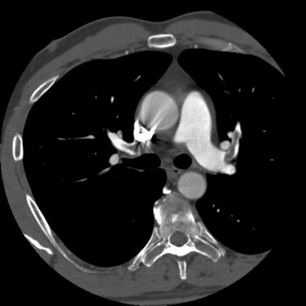
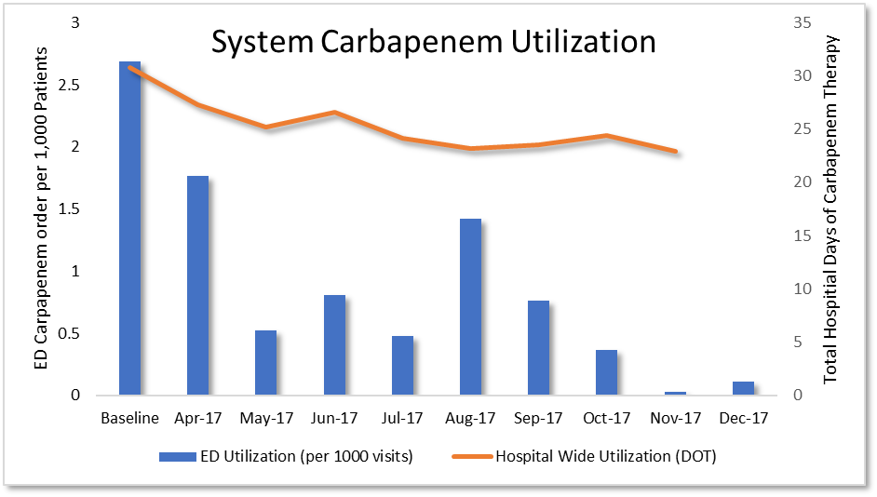
Outpatient treatment of venous thromboembolism
Aligning risk stratification, initiation of anticoagulants, and outpatient follow up in the ED
Pulmonary embolism and DVT may be safely treated as an outpatient in selected patients
Barriers to successful discharge of VTE patients include:
  Appropriate risk stratification
  Anticoagulant education for patients
  Affordability and accurses of DOAC
  Ensure follow up for all patients
To address these concerns the ED developed a free transition clinic, staffed by ED providers, to see VTE patients after discharge
To date, over 250 patients have been discharge from ED across IES sites.
This corresponds with $2.25 million in inpatient costs prevented
Our experience was shared at the 2017 AHA national conference

Slide 31
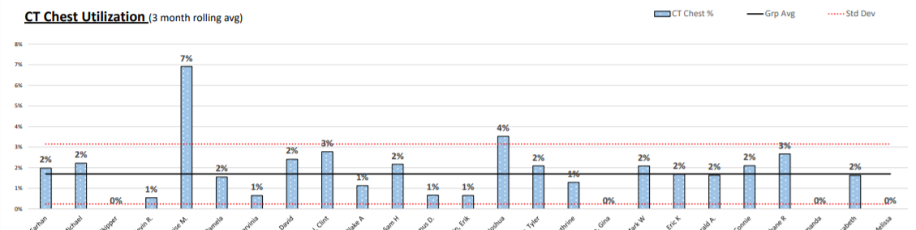
Utilization review
Reducing variation in practice though internal provider benchmarking
There is marked variation in the utilization of imaging within the ED
We developed an analysis that benchmarks providers against their own site to determine outliers in practice
This data is shared with individual providers. Outliers receive education and feedback.
Notes:
Use these as opportunities to educate providers and align treatment

Slide 32
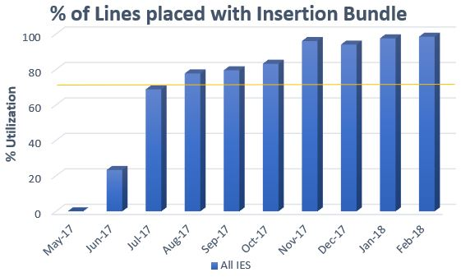
CLABSI Prevention
Focus on Standardizing Central Line Insertion Bundle, Pilot Bundle for BSW, Identifying and Communicating High Risk Lines
CLABSI prevention starts at line insertion.
BSW developed a standardized, checklist guided approach to line insertion: 50% reduction in CLABSI.
IES EDs piloted this workflow and checklist for BSW.
This is now the standard approach across all our ED’s.
Improved communication and alignment with critical care with potentially contaminated lines.

Slide 33
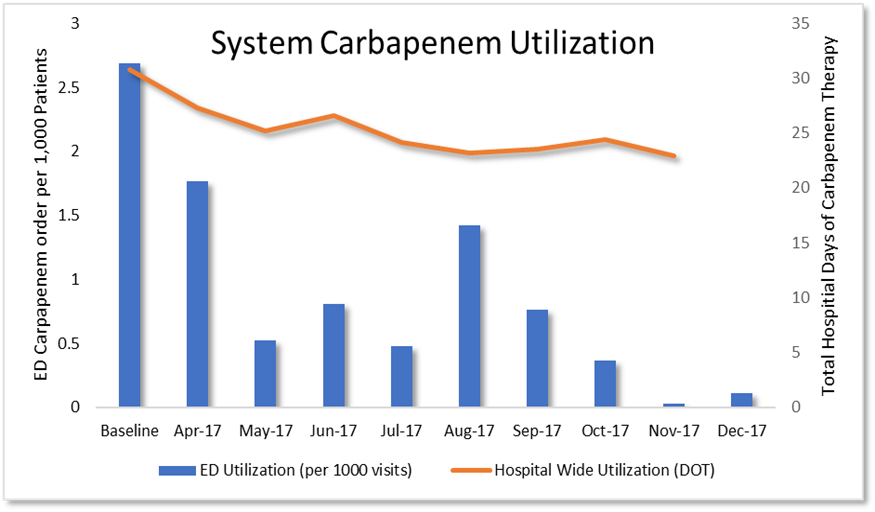
Antibiotic stewardship
ED practice can influence the entire hospital: Diffusion of best practice
We found that hospital providers tended to continue to empiric antibiotic choice initiated in the ED
In alignment with the BSW Antibiotic Stewardship Committee, we aimed to reduce use of carbapenem antibiotic in the ED
We saw a 89% reduction in Carbapenem utilization in Emergency Departments

Slide 34
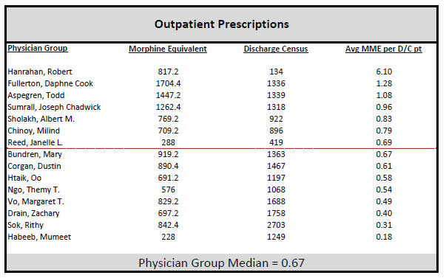
Opiate Safety
Responsible use of opiates to reduce adverse effects
Analyzed provider opiate prescribing patterns.
Converted all PO and IV opiates to morphine equivalents and normalize by patient encounters.
Noted marked variation between providers and sites.
Opiate utilization (both administered in the ED and by prescription) were shared with staff.
Ongoing comparative data is provided to physicians and APPs.

Slide 35
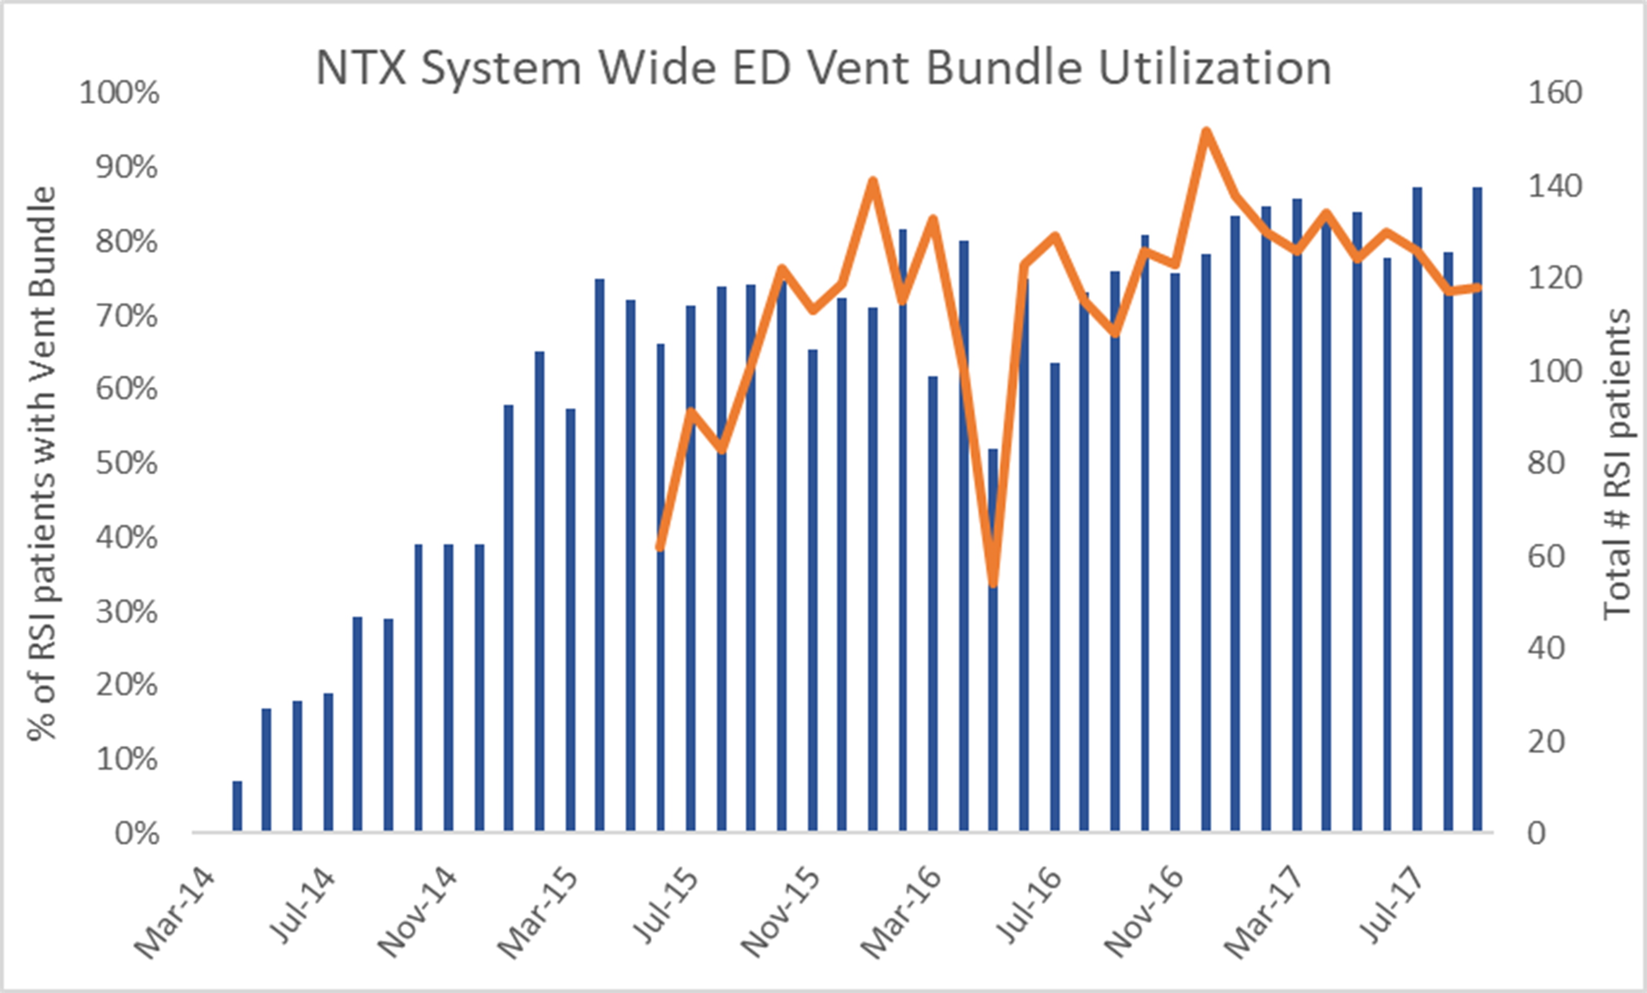
ED Ventilator bundle
Prevention of ARDS and Ventilator Associated Pneumonia starts in the ED
VAP and ARDS can be largely prevented though use of several evidence based interventions bundled together.
These Ventilator bundles have been widely adopted in the ICU, but are less often seen in the ED.
Newer evidence suggests use of the ventilator bundle in the ED dramatically decreases the risk of ARDS and VAP.
It appears that the brief exposure (2-3 hours) of large tidal volumes & lack of basic maneuvers is sufficient to case harm.
Use of the Ventilator Bundle in the ED is associated with a ~42% mortality reduction in ventilated patients.
Use of the Ventilator Bundle is the ED is associated with a cost savings of $17,500-19,500 per case.

Slide 36
ED Ventilator bundle
Prevention of ARDS and Ventilator Associated Pneumonia starts in the ED
Utilization of ED ventilator bundle has been hardwired across the NTX ED’s.
Over the past 3 years 2,489 people received the vent bundle.
This corresponds to:
  360 lives saved
  $45,000,000 in prevented healthcare costs

Slide 37
You Cant Manage What You Don’t Measure
Management thinker Peter Drucker is often quoted as saying that "you can't manage what you can't measure."
“I often say that when you can measure what you are speaking about, and express it in numbers, you know something about it; but when you cannot measure it, when you cannot express it in numbers, your knowledge is of a meagre and unsatisfactory kind; it may be the beginning of knowledge, but you have scarcely in your thoughts advanced to the state of Science, whatever the matter may be.” Lord Kelvin, 1883
Measure important things
  We should reconsider what we are measuring.
  Does this result in the desired end point?
  Does this data drive the bottom line?
  Does this data make us more customer centric?
  Does this data align our work force and management team?
Studer’s 9 Principles Of Success
Notes:
5. Slide 39 is a MAJOR take home point relating to the EDOSG mission. We’d add that thoughtful measure require consideration of the best statistical use of data. You go beyond “statistical” considerations with the 5 bullet points at the bottom. Many of the folks on the research side often under appreciate this importance of “strategic metrics” this is such an important point for this crowd. Would be great if you could fit in these points with a transition to your “category” examples on page 40

Slide 38
Use simple tools
Standardized paper data collection tool
Use programs already available
Use Excel
Use Survey Monkey
Databases

Slide 39
Metrics
Customer Satisfaction
  Patients, Administrators, consultants, corporation
Process
  Volume, throughput, interval times
  Charting completion
  Order set utilization
Process Improvement
  Timeline
Decreased variation
  Utilization Review
Outcomes

Slide 40
3 Pools of Data
Individual Provider
Institution
System
Notes:
Slide 41 mirrors the levels of work the EDOSG is promoting. Hope you can take the time to explain what you get from and at data analysis at each of these levels before you transition to the metrics in the slides to follow.

Slide 41
IES metrics
  Executive Dashboard
  Presidents Dashboard
  Operations Dashboards
  Provider Scorecards
  Utilization Review
  CIP Metrics
  QSP Metrics

Slide 42
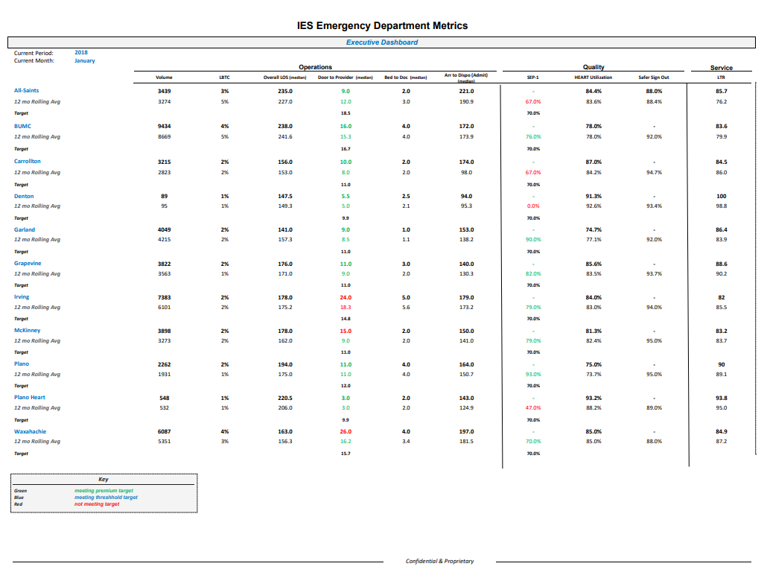

Slide 43
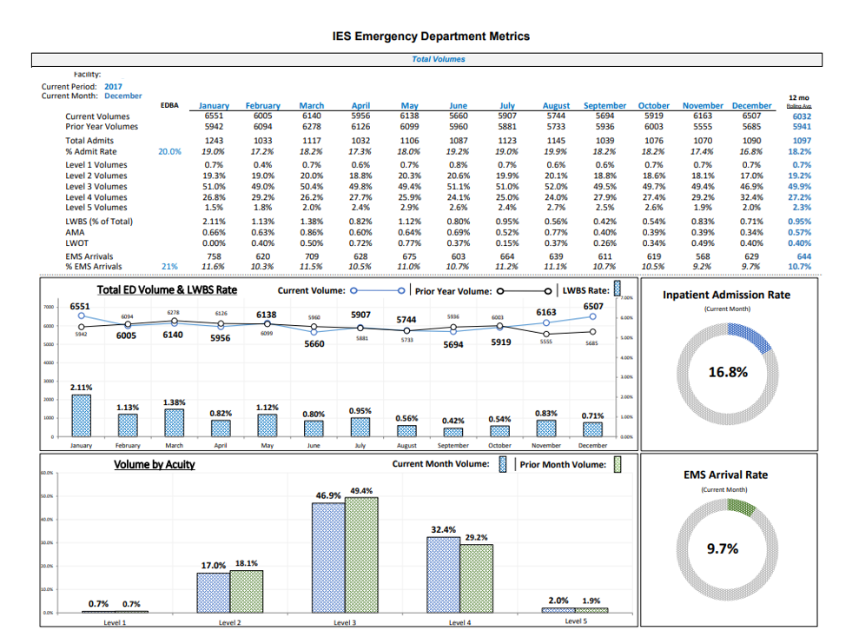
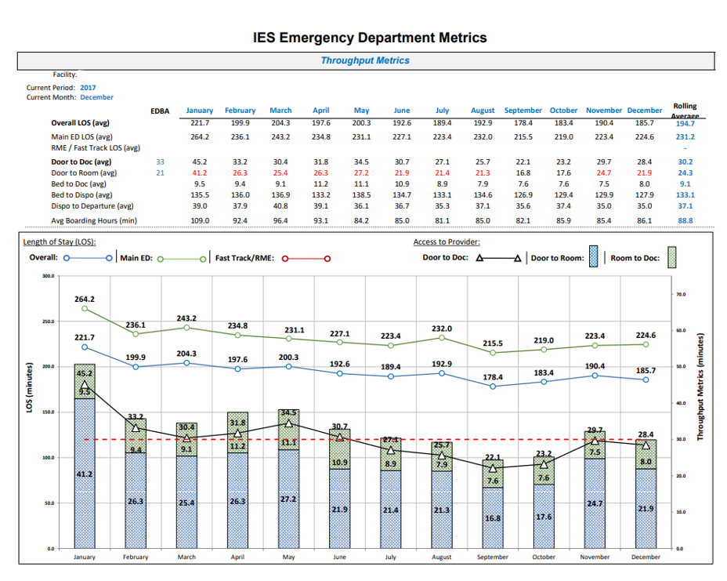
Operations dashboard sample
Volumes & Throughput Metrics
Pages 3-4

Slide 44
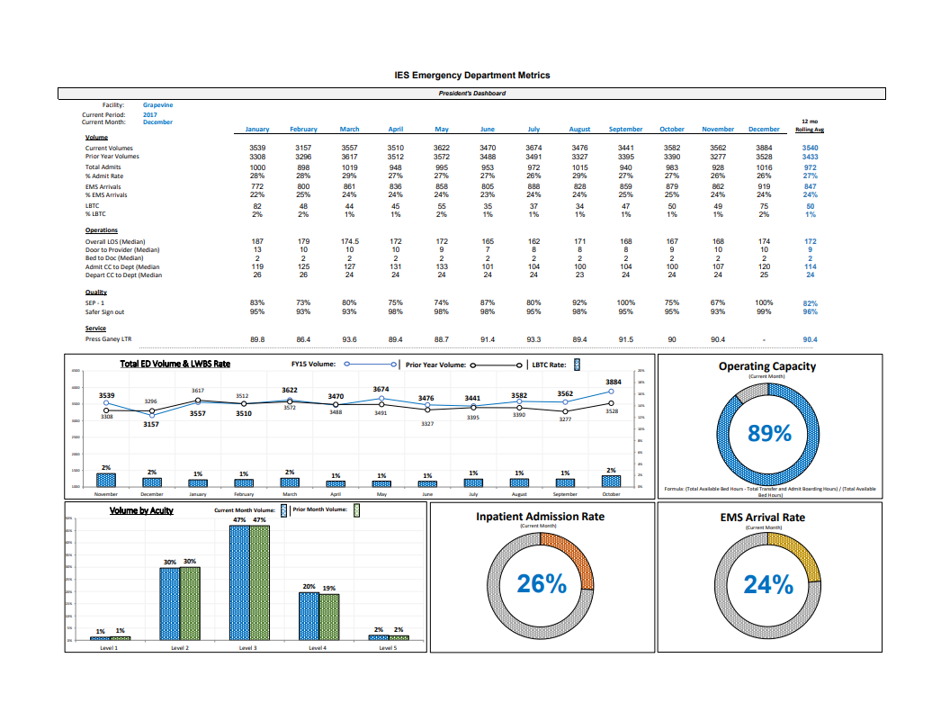

Slide 45
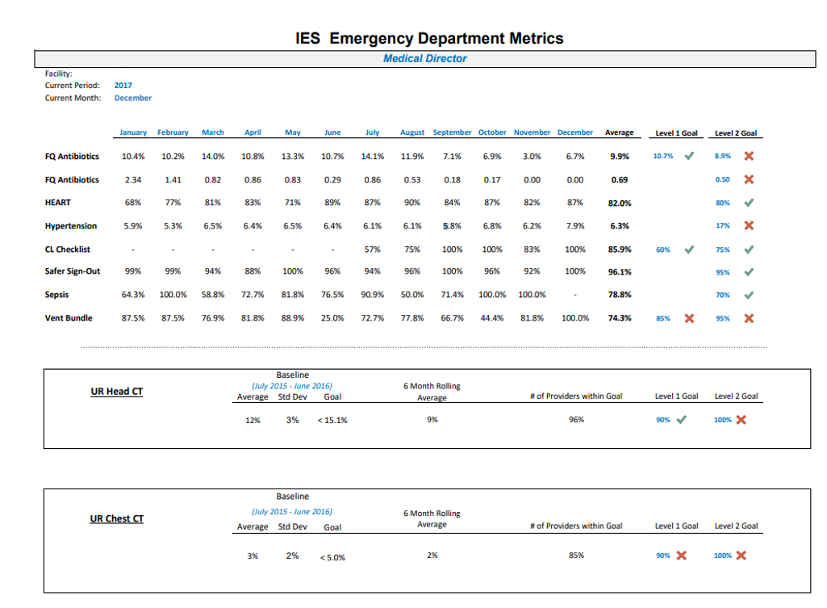
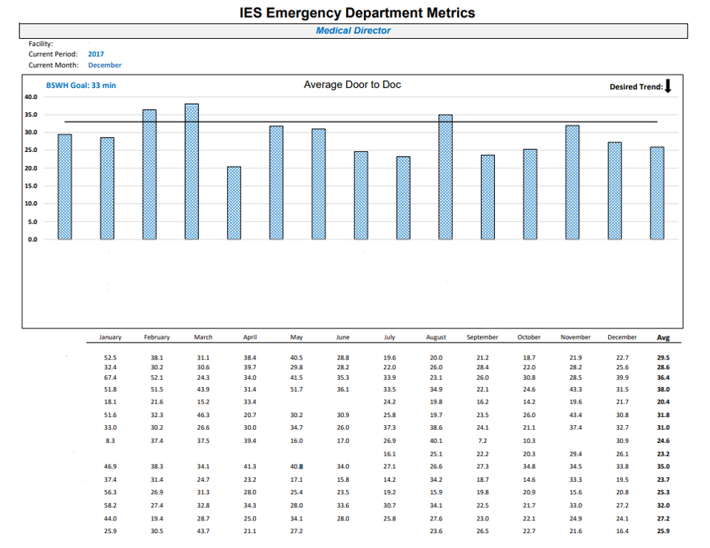
Operations dashboard sample
Emergency Department Metrics
Pages 1-2

Slide 46
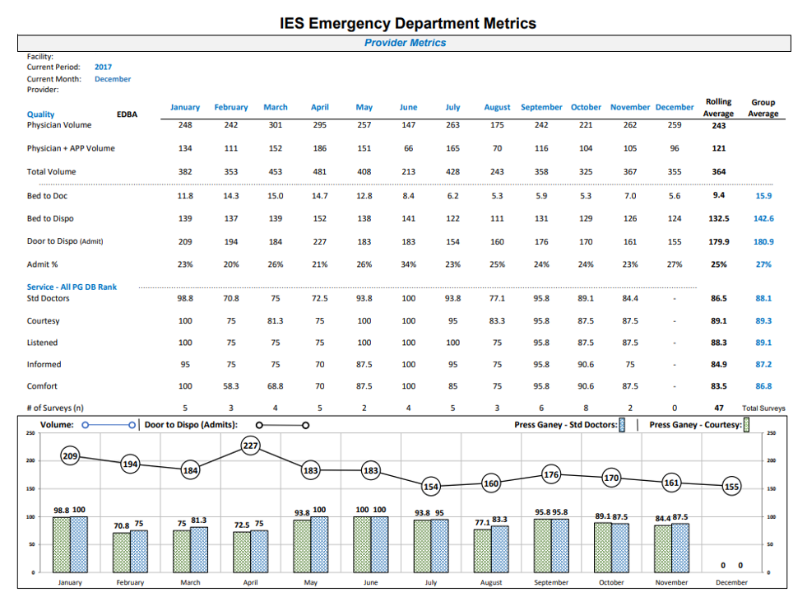
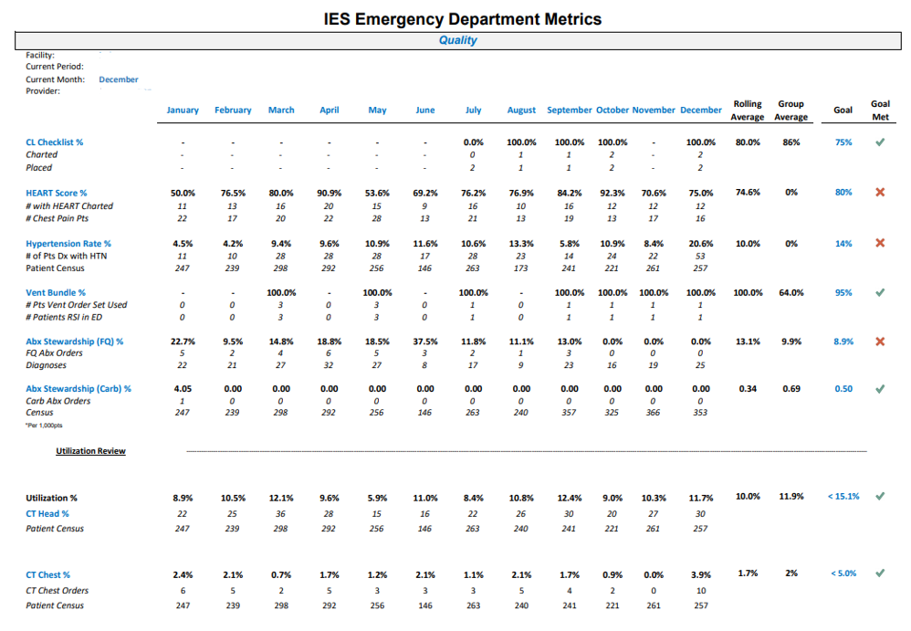
Individual Provider score cards

Slide 47
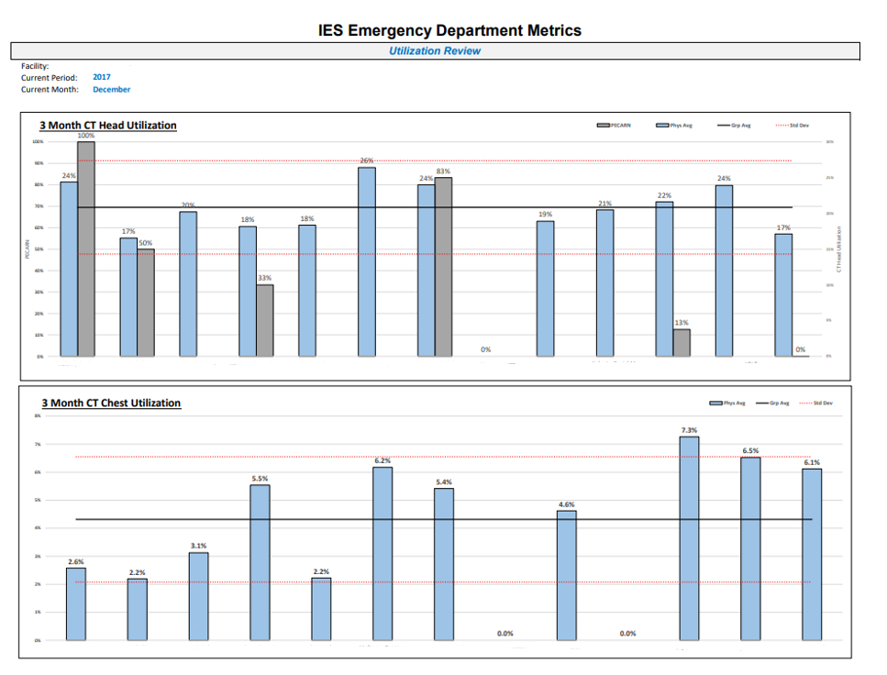

Slide 48
Caveats
Bring staff along – explain the “Why”.
Program duration for maximal effect.
Data specifics – comparison between sites, unblinded, goals.
Make the data actionable when possible
Make it easy to do the right thing.

