Slide 1


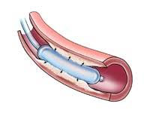
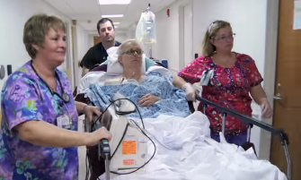
EDOSG National STEMI Initiatives
In Partnership with the HSR-DCC
Maame Yaa A. B. Yiadom, MD, MPH, MSCI

Slide 2

National Practice Epidemiology
Acute Coronary Syndrome Screening and Diagnostic Practice Variation
Maame Yaa A. B. Yiadom MD MPH, Xiulei Liu MSc, Conor M. McWade MPH, Dandan Liu PhD, Alan B. Storrow, MD
The ED Operations Study Group
March 2017
62 Emergency Departments
15% do not have formal STEMI screening
14% use “chest pain” as the sole criteria
Suggests nearly 30% have inadequate screening

Slide 3

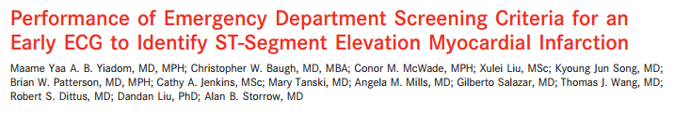

STEMI Screening Performance
Variable Emergency Department (ED) STEMI Screening
Performance and Patient Impact?
Maame Yaa A. B. Yiadom MD MPH, Christopher W. Baugh MD MBA, Conor M. McWade MPH, Xulei Lu MSc, Kyoung Jun Song MD, Brian Patterson MD MPH, Cathy Jenkins MSc, Mary Tanski MD MBA, Gilberto Salazar MD, Thomas J. Wang MD,
Robert S. Dittus MD MPH, Dandan Liu PhD, Alan B. Storrow MD
March 2017

Slide 4
STEMI Screening Performance
Variable Emergency Department (ED) STEMI Screening
Performance and Patient Impact?
Maame Yaa A. B. Yiadom MD MPH, Christopher W. Baugh MD MBA, Conor M. McWade MPH, Xulei Lu MSc, Kyoung Jun Song MD, Brian Patterson MD MPH, Cathy Jenkins MSc, Mary Tanski MD MBA, Gilberto Salazar MD, Thomas J. Wang MD,
Robert S. Dittus MD MPH, Dandan Liu PhD, Alan B. Storrow MD
March 2017
12.8% (Range 3.4-32.6%) Missed at Screening
Patients missed by initial ED screening experience 14-80 minutes of additional myocardial ischemia time*

Slide 5

STEMI Screening Performance and Disparities
Demographic Differences
Timely and Untimely Care
Outcome Differences Associated With STEMI Diagnostic Delay: Disparities on the Frontlines of STEMI Care
Maame Y Yiadom, Christopher Baugh, Cathy A Jenkins, Mary Tanski, Bryn E. Mumma, Timothy J Vogus, Karen F Miller, Brittney E Jackson, Christoph U Lehmann, Stephen C Dorner, Jennifer L West, Olayemi O Olubowale, Thomas J Wang, Sean P Collins, Robert S Dittus, Gordon R Bernard, Alan B Storrow, Dandan Liu.
Originally published. 2018;11:A185
Patients who did not receive and ECG within 10 minutes were
More commonly
Female (55% vs. 19%, p=0.001)
non-white (87% vs. 65%, p =0.028)
Reported chest pain or shortness of breath less frequently (55% vs. 94%, p<0.001).
Experienced longer
Median door-to-cathlab-arrival (159 vs. 50 minutes, p=0.004)
Median door-to-balloon time (207 vs. 93 minutes, p=0.048).

Slide 6
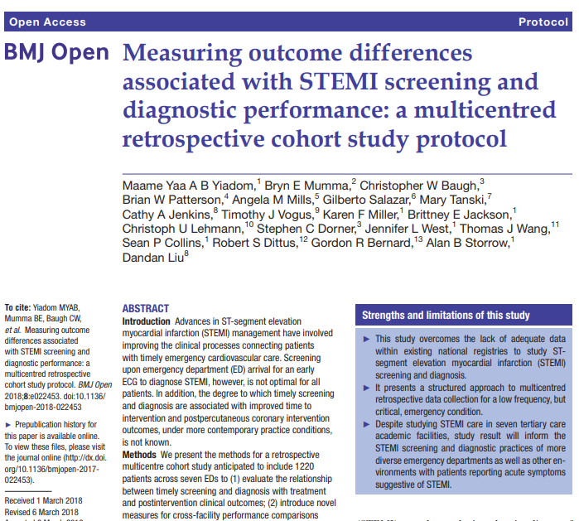
Emergency Care STEMI Registry
ED Arrival
Screening
Diagnosis
Cath lab Activation
Cath lab Arrival
Balloon Intervention

Slide 7
Emergency Care STEMI Registry
Thrombolysis and PCI patients have different targets for “timely treatment.”
Challenged to study thrombolysis.
From the perspective of the tertiary care center
  Screening and diagnosis is generalizable to all EDs
  We can look back on the care of transferred PCI patients to understand care course from the referring facility to treatment

Slide 8
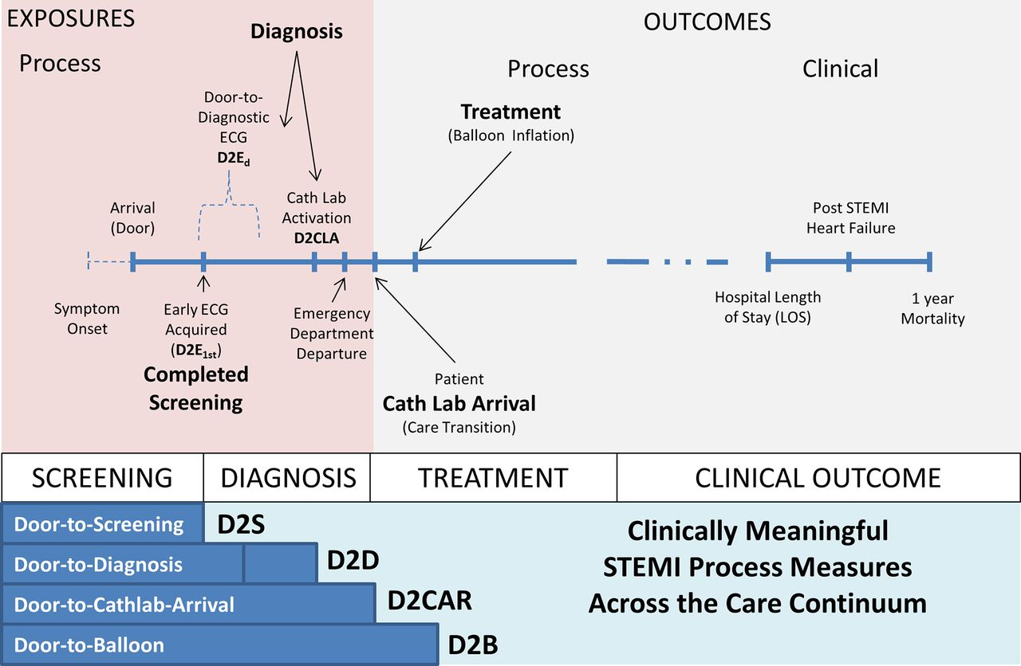
Emergency Care STEMI Registry

Slide 9
Sub-Cohorts of STEMI Patients
Patients transferred for PCI can see 2 EDs
  Produces “negative” door-to-balloon time for the 2nd ED
  Artificially makes receiving facility D2B metrics look better than they may actually be
  At least 2 ED STEMI patient populations:
    Diagnosed elsewhere and referred for care
    ED diagnosed
“Diagnosed elsewhere” = Pre-arrival cath lab activation
  Referring physician provider
  EMS
  All STEMI patients may experience the same care steps,
  but they may not be initiated by the same provider
  or in the same order

Slide 10
Sub-Cohorts of STEMI Patients
3 “Location of Diagnosis” Sub-Cohorts
ED Diagnosed: ED Physician Activation
EMS Diagnosed: EMS Activation
Referred: OSF -> On-call Cardiology Activation

Slide 11
STEMI Patients Flow Through the Emergency STEMI Care System
ED Diagnosed
Walk-in
N=XXX
START
EMS
N=XXX
Referred
EMS Diagnosed
EMS
N=XXX
Screening ECG
N=XXX
Screening ECG
N=XXX
Screening ECG
N=XXX
ED
Arrival
N=XXX
OSH
N=XXX
OSH
N=XXX
Diagnostic ECG
N=XXX
Screening ECG
N=XXX
Diagnostic ECG
N=XXX
Screening ECG
N=XXX
Diagnostic ECG
N=XXX
OSH
N=XXX
Cath Lab Activation
(Direct)
N=XXX
EMS
N=XXX
Screening ECG
N=XXX
Cath Lab Activation
(Direct)
N=XXX
EMS
N=XXX
Cath Lab Activation
(Direct)
N=XXX
EMS
N=XXX
Cath Lab Activation
(Direct)
N=XXX
Cath Lab Activation
(ED Facilitated)
N=XXX
ED
Arrival
N=XXX
ED
Arrival
N=XXX
OSH
N=XXX
Diagnostic ECG
N=XXX
ED
Arrival
N=XXX
Diagnostic
ECG
N=XXX
EMS
N=XXX
Cath Lab Activation
(Direct)
N=XXX
Cath Lab Activation
(ED Facilitated)
N=XXX
ED
Arrival
N=XXX
Cath Lab Activation
(ED Facilitated)
N=XXX
ED
Arrival
N=XXX
Cath Lab Activation
(Direct)
N=XXX
Cath Lab Activation
(ED Facilitated)
N=XXX
Cath Lab Activation
(Direct)
N=XXX
Cath Lab Activation
(ED Facilitated)
N=XXX
EMS
N=XXX
ED
Arrival
N=XXX
Cath Lab
Arrival
N=XXX
Angiography but no intervention
END
PCI
N=XXX

Slide 12
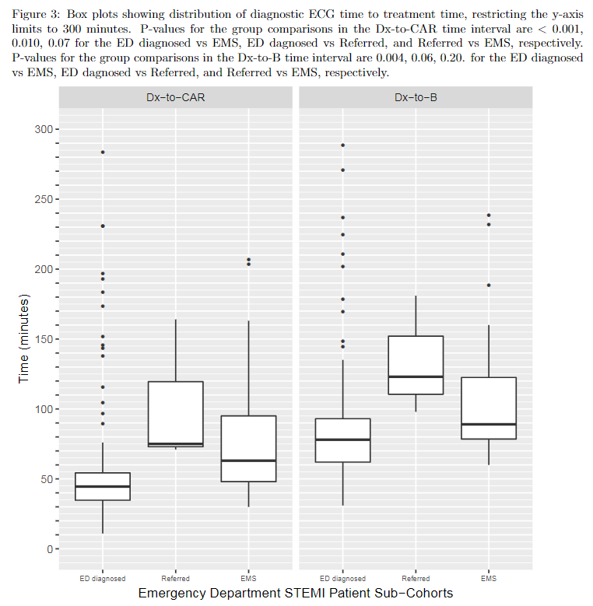

Sub-Cohorts of STEMI Patients: Diagnosis to Treatment
Diagnosis to Cath Lab Arrival Time
Diagnosis to Balloon Time
ED DIAGNOSED
REFERRED
EMS
ED DIAGNOSED
REFERRED
EMS
Emergency Department STEMI Patient Sub-Cohorts

Slide 13
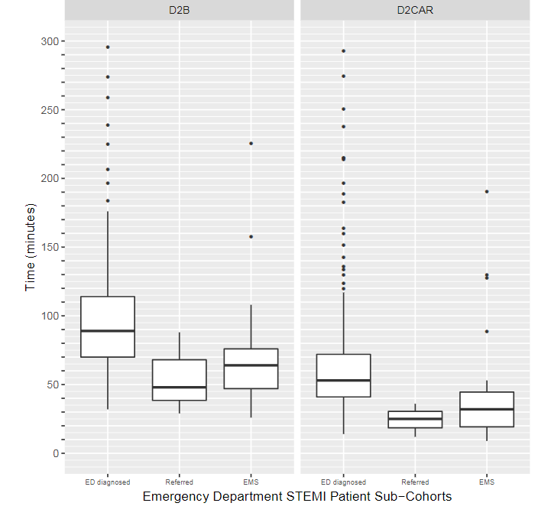
Sub-Cohorts of STEMI Patients: Door to Treatment
Door to Cath Lab Arrival Time
Door to Balloon Time
ED DIAGNOSED
REFERRED
EMS
ED DIAGNOSED
REFERRED
EMS

Slide 14
Sub-Cohorts of STEMI Patients: Door vs Diagnosis
A
Door to Balloon Time
Diagnosis to Balloon Time
B
Door to Cath Lab Arrival Time
Diagnosis to Cath Lab Arrival Time
123
92
80
89
74
64
54
89
48
46
30
32
ED DIAGNOSED
REFERRED
EMS
ED DIAGNOSED
REFERRED
EMS
ED DIAGNOSED
REFERRED
EMS
ED DIAGNOSED
REFERRED
EMS

Slide 15
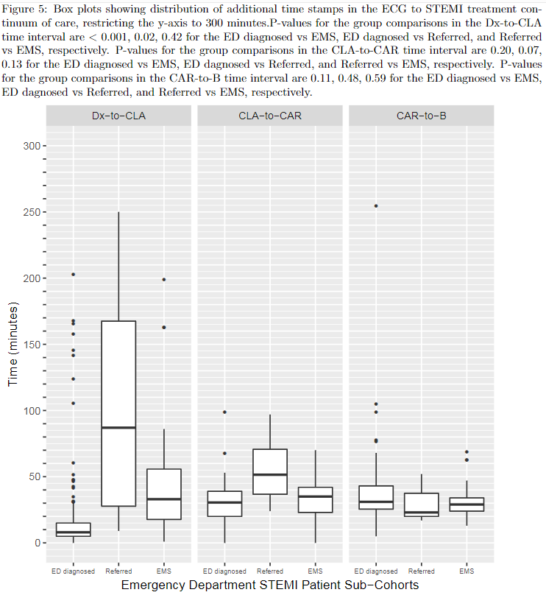
Sub-Intervals of Care for STEMI: By Sub-Cohort
Diagnosis to Cath Lab Activation
Cath Lab Activation to Lab Arrival
Cath Lab Arrival to Balloon Time
A
B
C
ED DIAGNOSED REFERRED
EMS
ED DIAGNOSED REFERRED
EMS
ED DIAGNOSED REFERRED
EMS

