Slide 1

Membership, Reach, and Advocacy
2018 Update
Maame Yaa “Maya” A. B. Yiadom, MD, MPH, MSCI
Founding Director
EDOSG 2018 Conference
Nashville, Tennessee

Slide 2
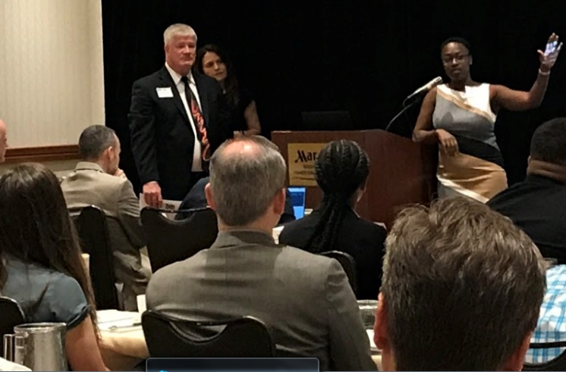


What the EDOSG is About
Mission and Vision
Members
Objective

Slide 3
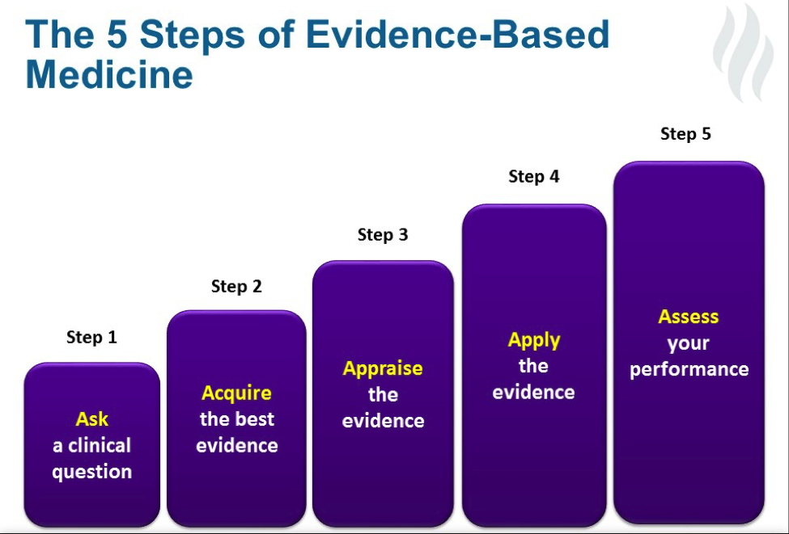
Evidence-Based Medicine
The Approach
v
Clinical Practice

Slide 4



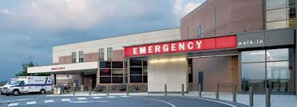
Evidence-Based Medicine
The Approach
v
Clinical Practice
Understanding what is common among patients or facilities…
…In addition to what is different

Slide 5




The Approach
Collecting and disseminating comparative emergency department data across facilities
Participating in the development of ED clinical operations research methods
Advocating for standard data reporting
Serving as a data sharing network

Slide 6
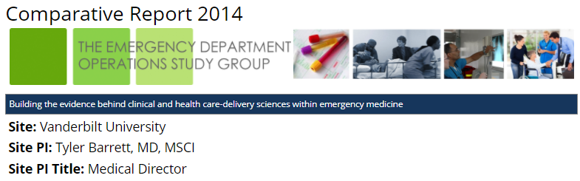
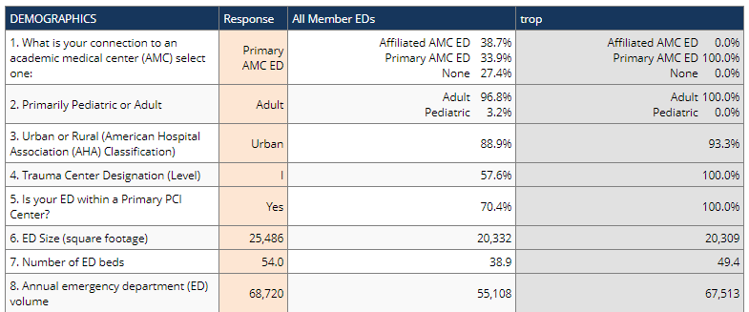
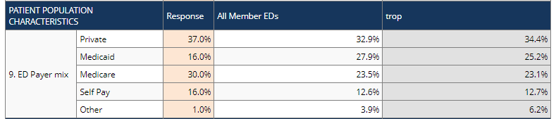
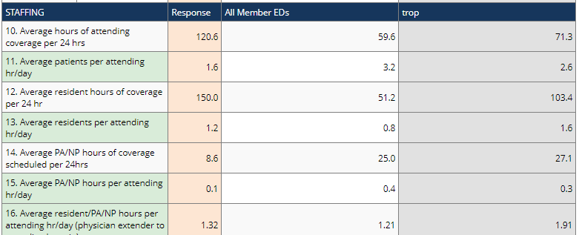
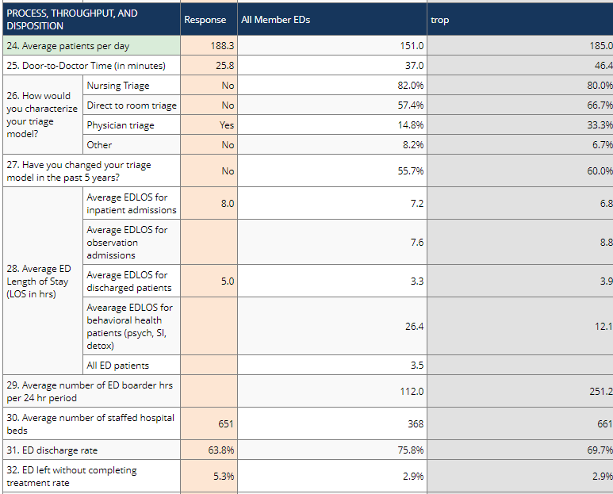
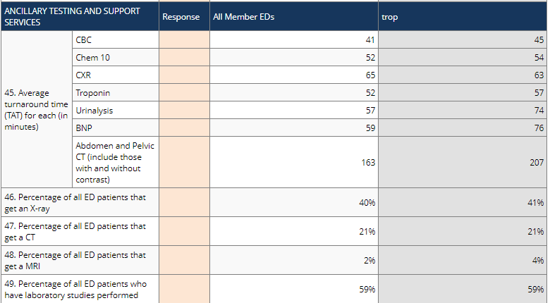
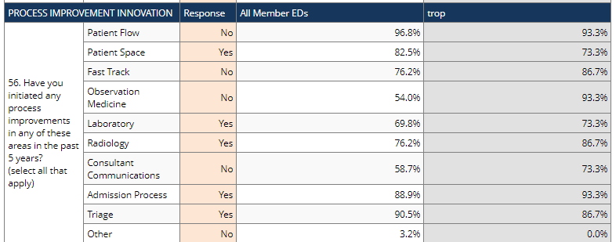
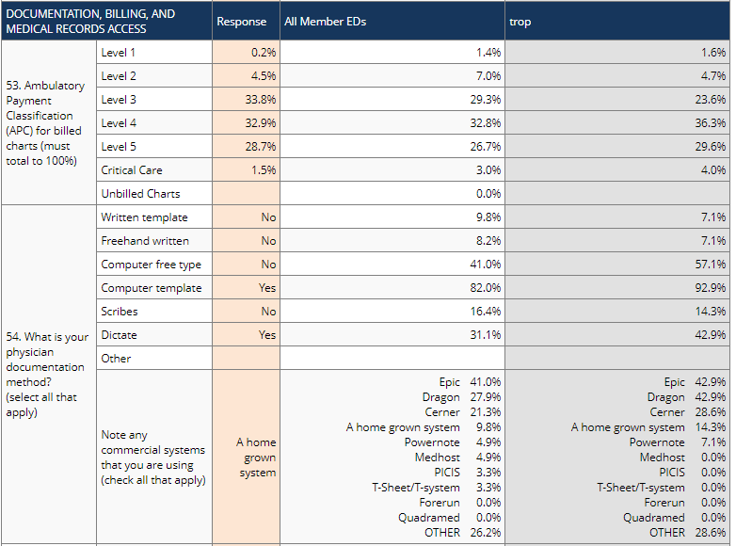
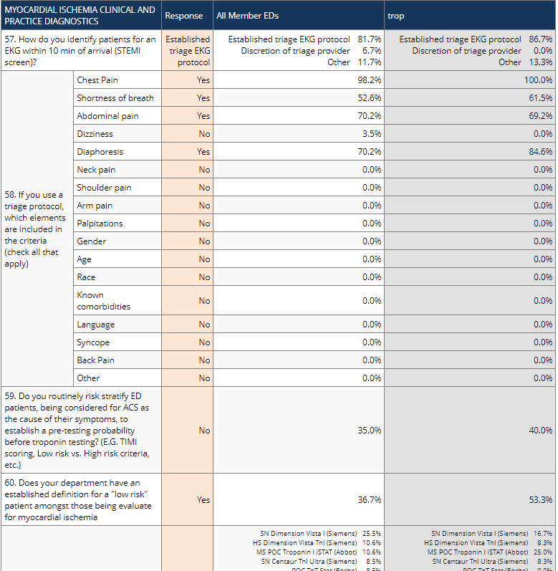
Comparative Data
Comparative Report 2017

Slide 7
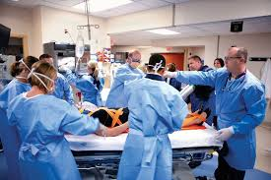
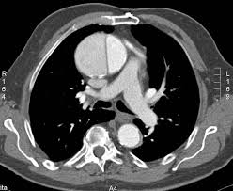
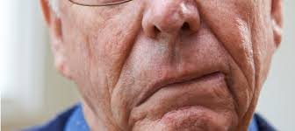
Clinical Priorities
Time-sensitive emergency conditions, with time-limited interventions
STEMI = Prototype Disease

Slide 8
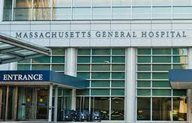




History
2009
2011
2014

Slide 9
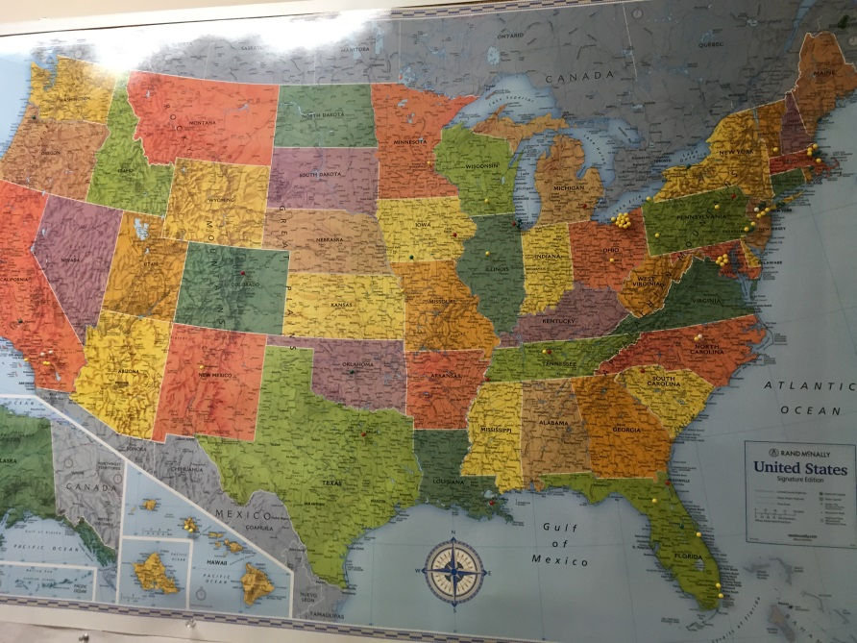
History
2018 90 Emergency Department
  50% Academic
  50% Community Practice
  10% Critical Access Centers

Slide 10




National
Collaboration

Slide 11

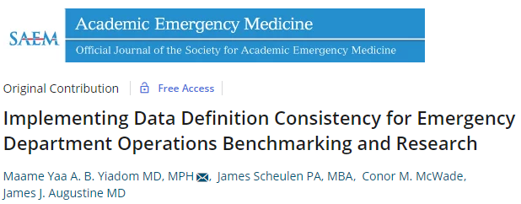

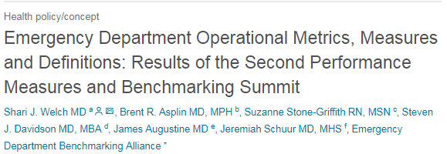
National
Common Measures

Slide 12
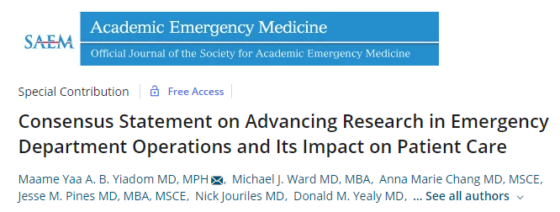
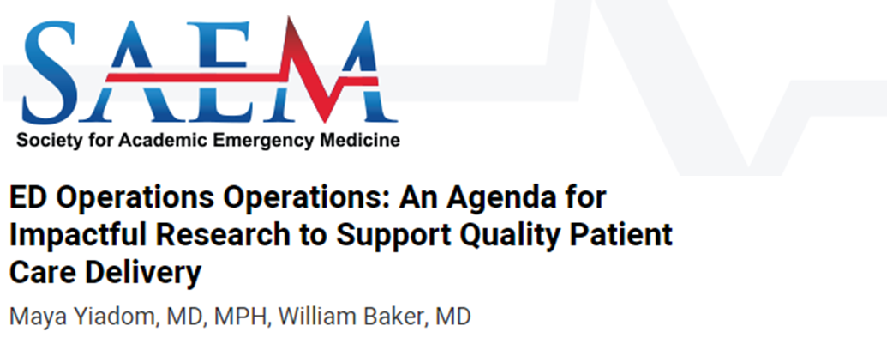
National
Research Agenda

Slide 13
National
Didactics
EDOSG National Conferences: 2014, 2017, 2018
Clinical Operations Research Didactics - Society for Academic Emergency Medicine
Poster Session EDBA’s Innovations in ED Management

Slide 14





Maame Yaa Yiadom
MD MPH
Principal Investigator
2018
Administrative Support
Scientific Staff
Research Interns
Brittney Jackson Program Coordinator
25%
Dandan Liu, PhD
Biostatistical
Co-Investigator
5%
Monisha Bhatia JD/MPH
MS4 Vanderbilt
Lead Intern
Yemi Olubowale MS Vanderbilt
Devin Rickard MS2 Meharry
Cathy Jenkins, MS
Staff Biostatistician
10%
Whitney Hucks
MS2 Meharry
Charles Latimore
MS2 Meharry
Pam Watson
Multi-Center Data Use Agreements and Contracts
Data Management System
(DMS)
90
Emergency Department Members
Victoria Antonello
2nd Yr Undergrad Vanderbilt
Brandon McBay
4th Yr Undergrad
Vanderbilt
HSR-DCC WORK PLAN
Scientific Aims Driven
Clinical Research Studies
Dr. Cliff Freeman PGY1
Vanderbilt EM
Dr. M. Roberson
PGY 2
Vanderbilt EM
Christy Kampe
IRB Specialist and Research Study Compliance
Karen Miller, RN
(Data Integrity Officer)
Dr. David Xu
PGY2
Vanderbilt EM
Scientific Advisory Committee (SAC): Alan Storrow MD, Gordon Bernard MD, Sean Collins MD Msci, Thomas Wang MD, Robert Dittus MD MPH,
Christianne Roumie MD MPH, Christoph Lehmann MD, Vikram Tiwari PhD, Timothy Vogus PhD
Non-Profit Organization
Vanderbilt University

Slide 15



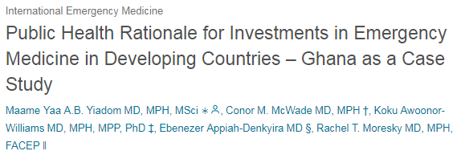
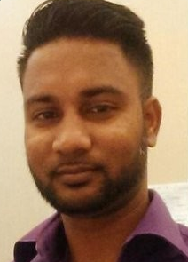
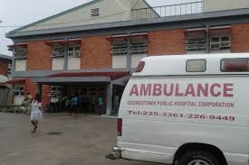
International
1st International Member ED
Balram Doodnauth, MD
Associate Medical Director
Georgetown Public Hospital Corporation
Emergency Department
Georgetown, Guyana
Recipient of the ED Benchmarking Alliance Sponsored Scholarship to attend the EDOSG Conference

Slide 16

Scope our Breadth…
… Fill our Depth

